Slide 1

The role of climate legacies in shaping extinction risk throughout Earth's history
University of Bayreuth
Gregor Mathes
PhD Defense
02.02.2023

Slide 2

But while nature has considerable resilience, there is a limit to how far that resilience can be stretched. No one knows how close to the limit we are getting.
Douglas Adams, Last Chance to See

Slide 3
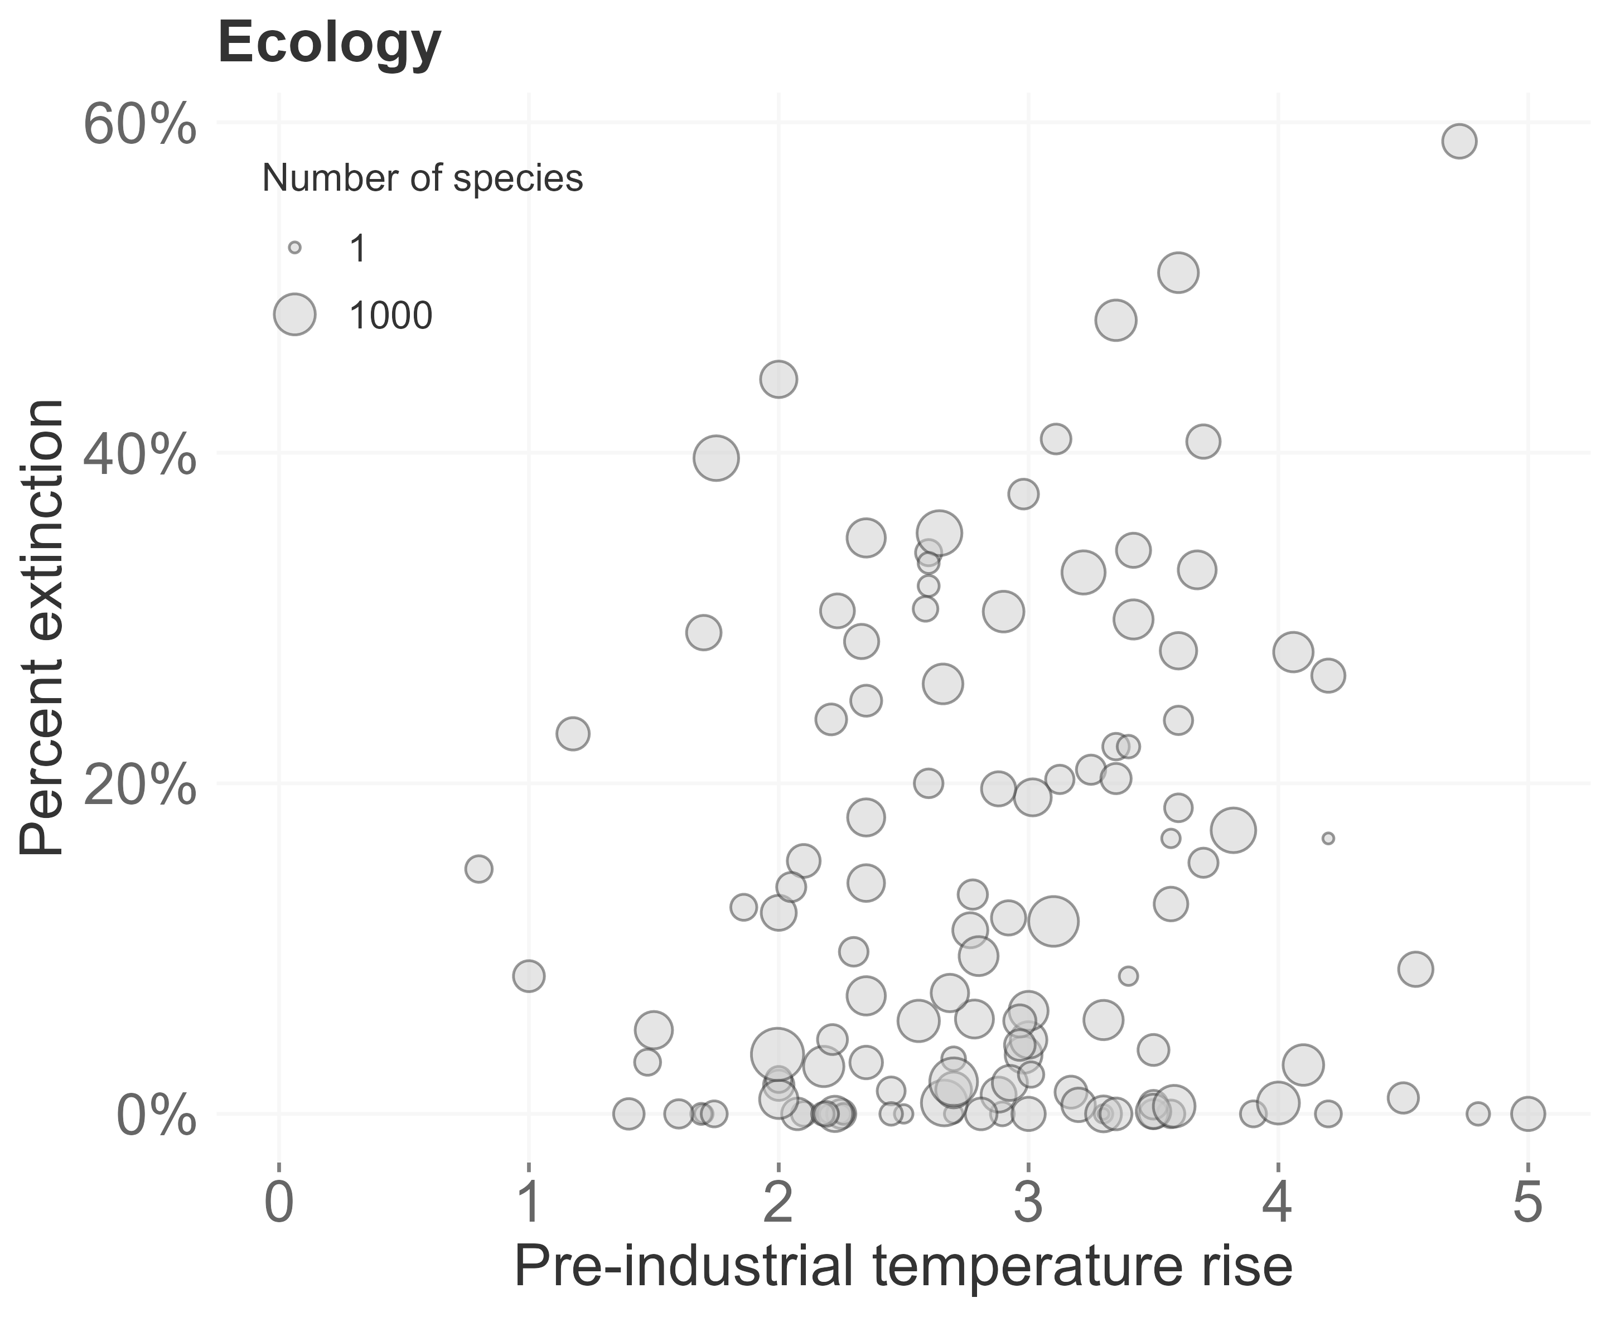
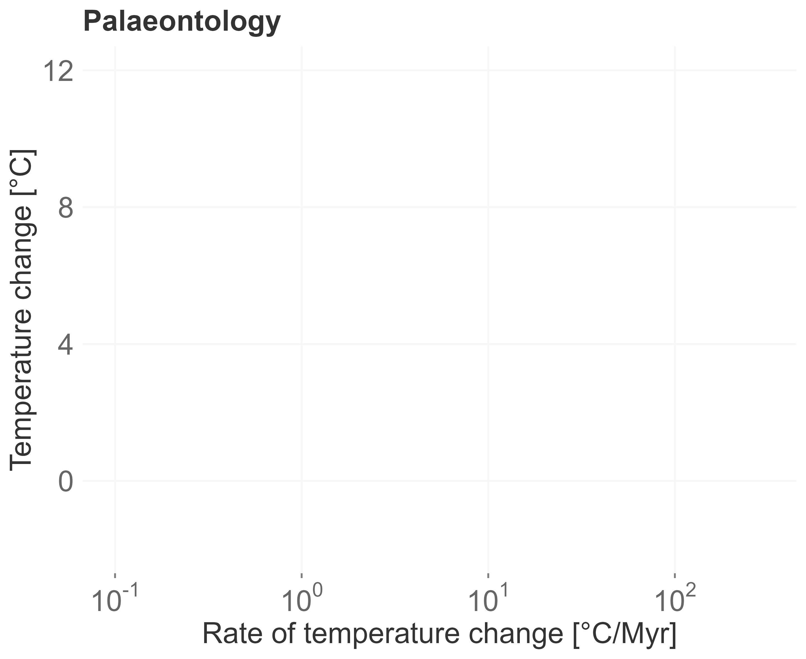
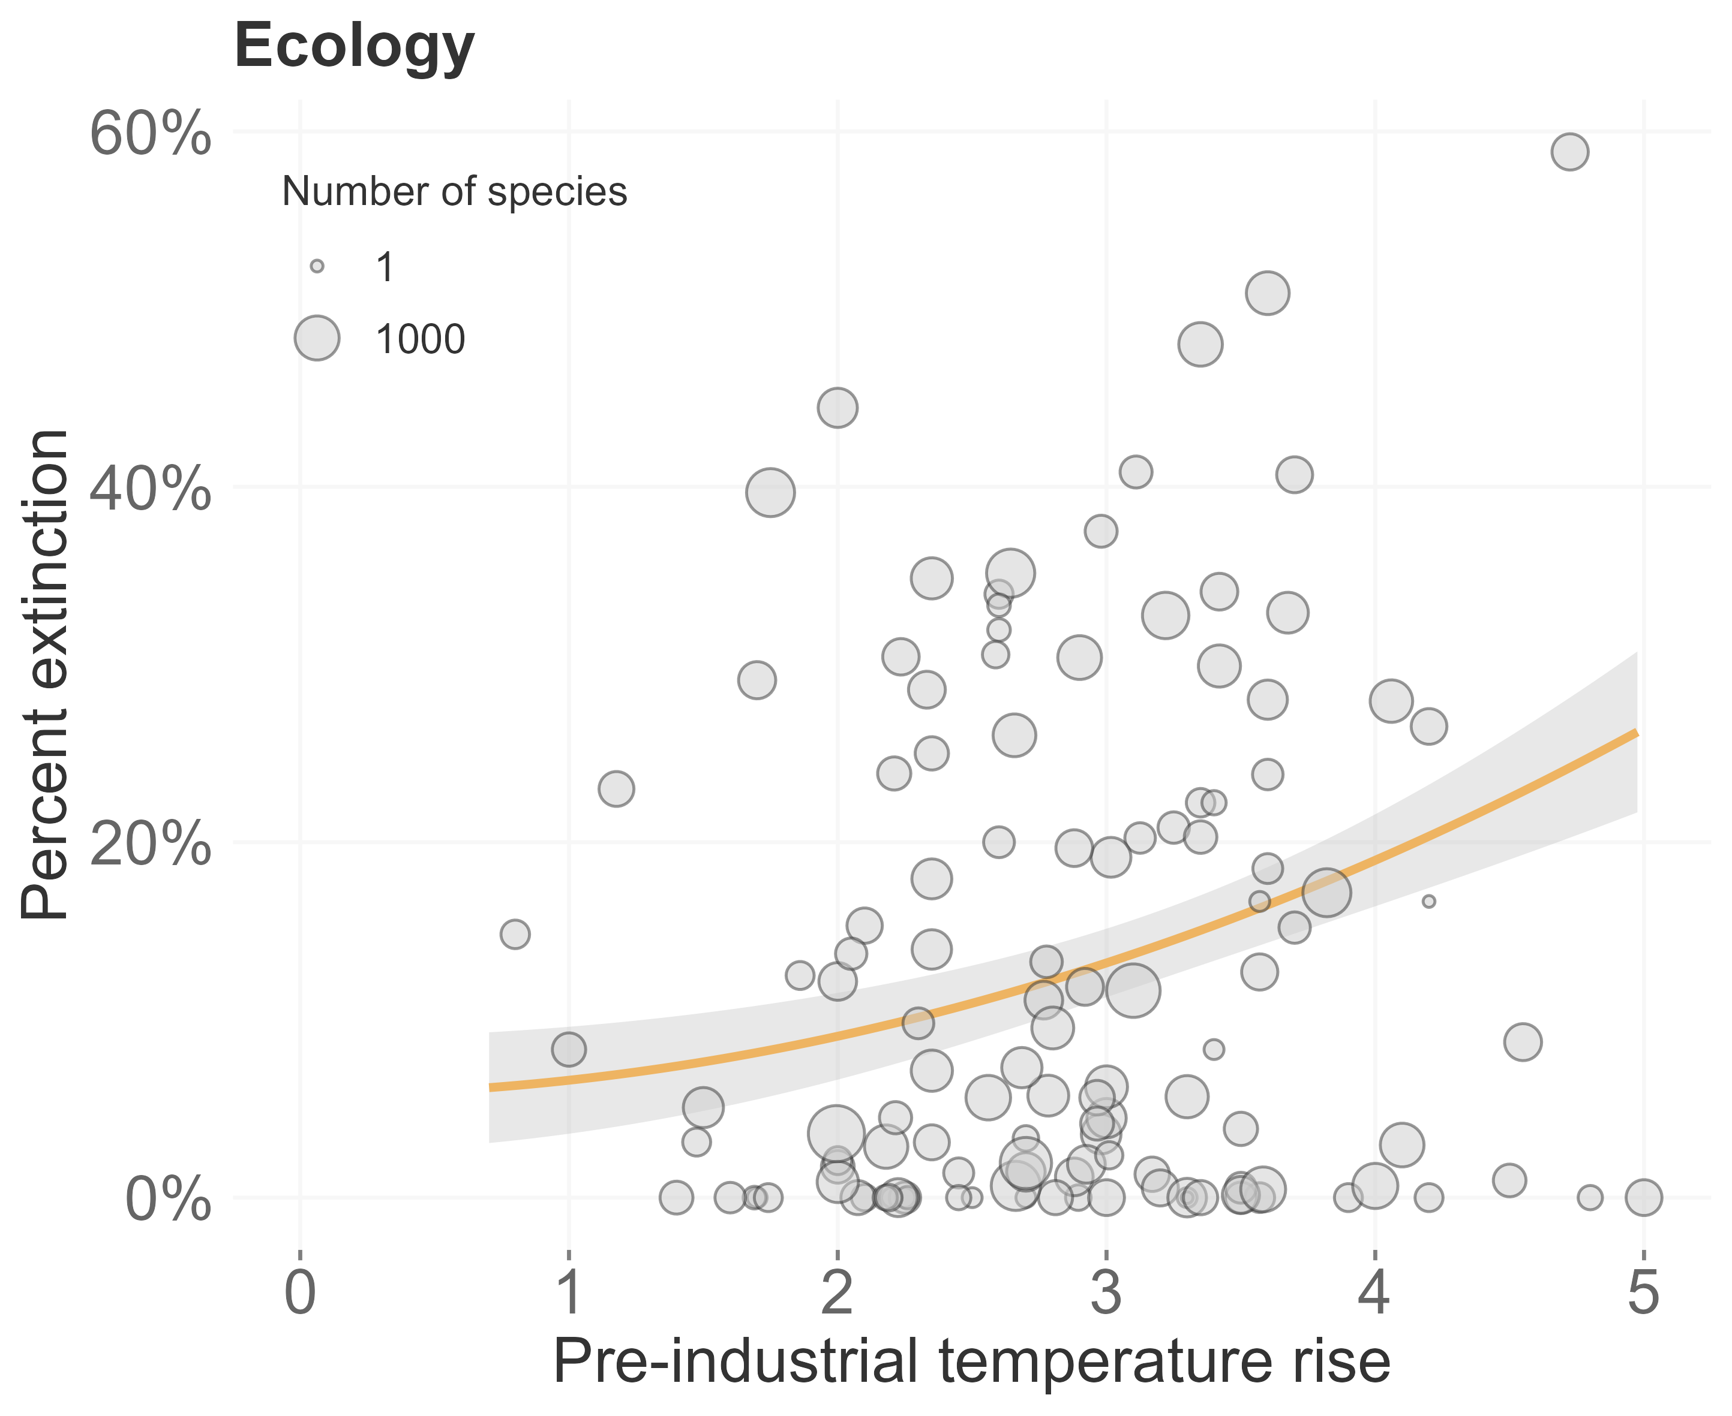
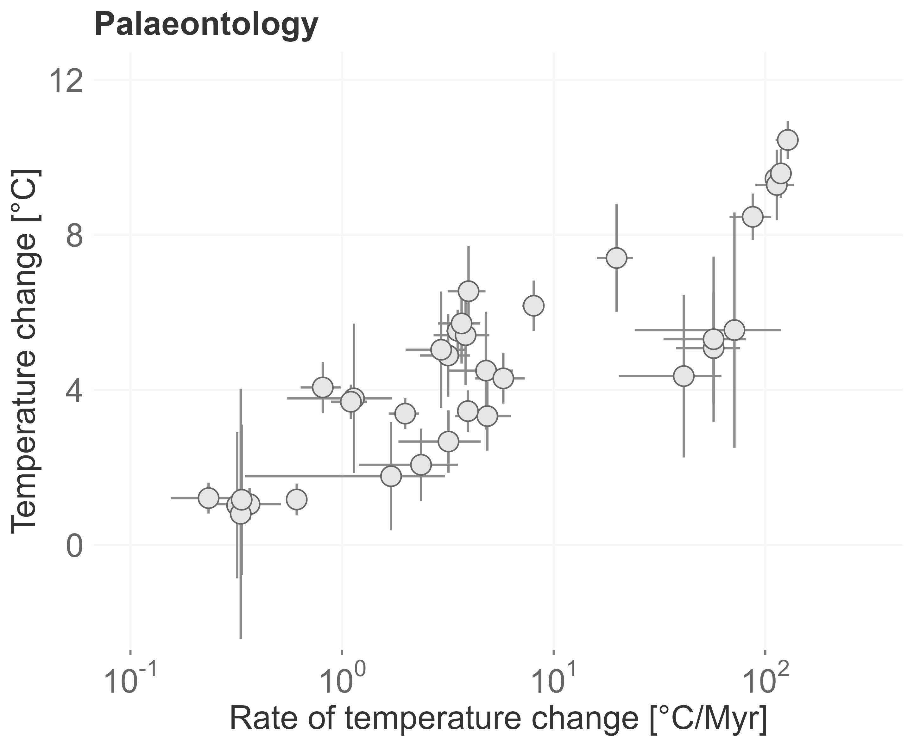
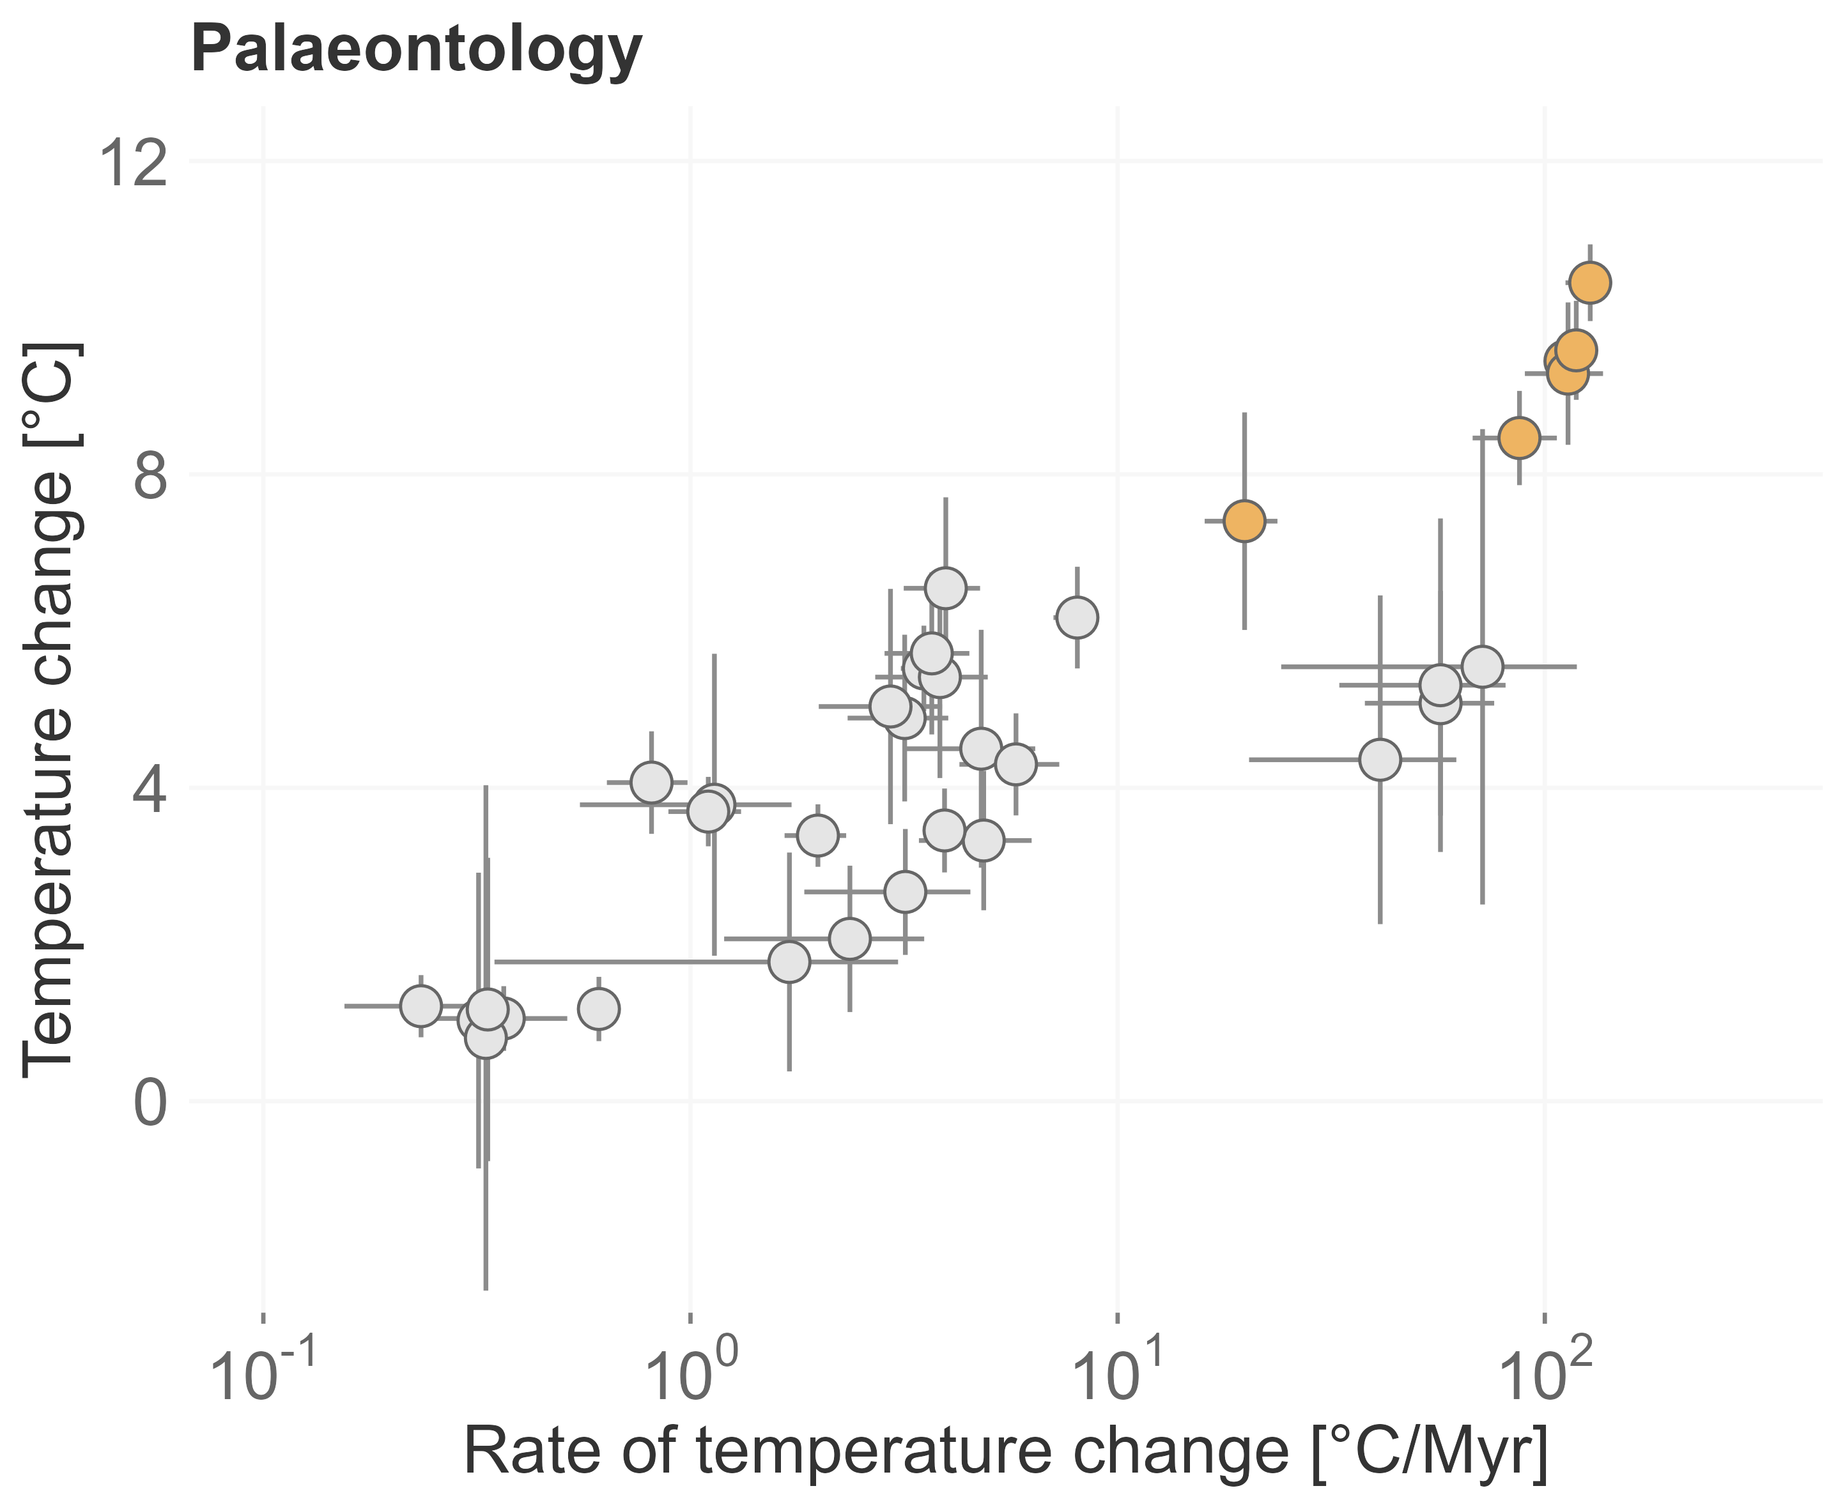

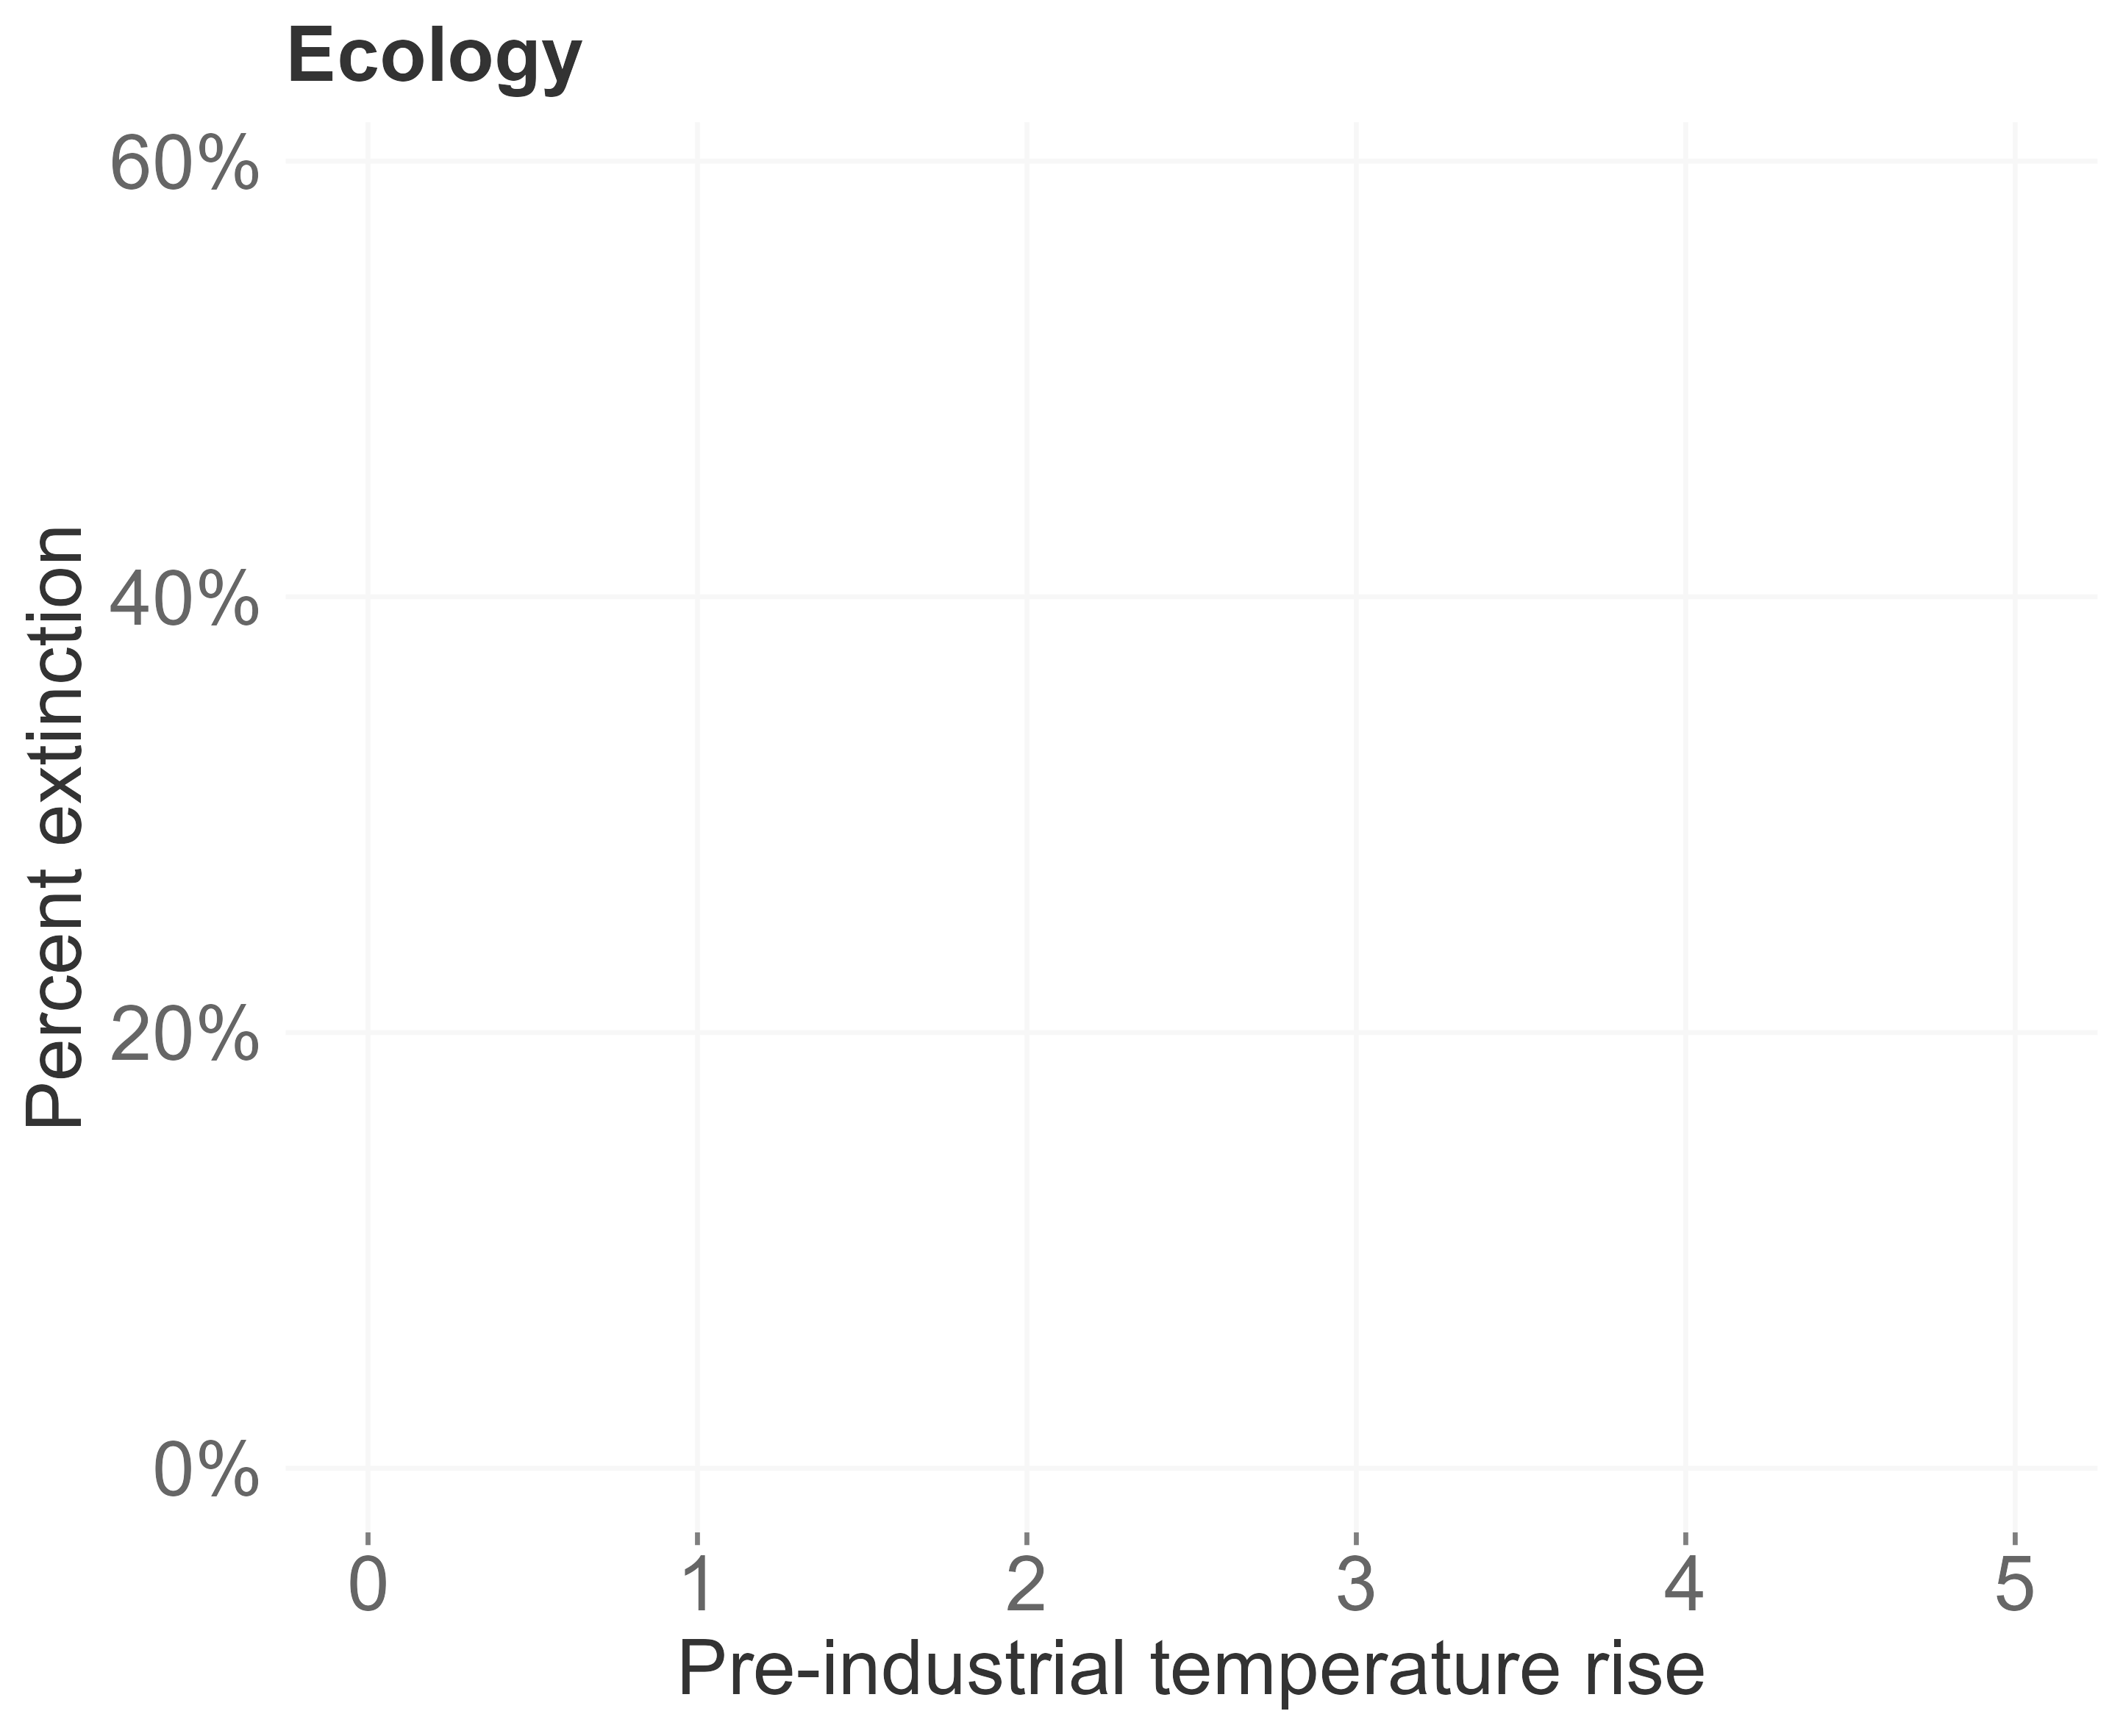
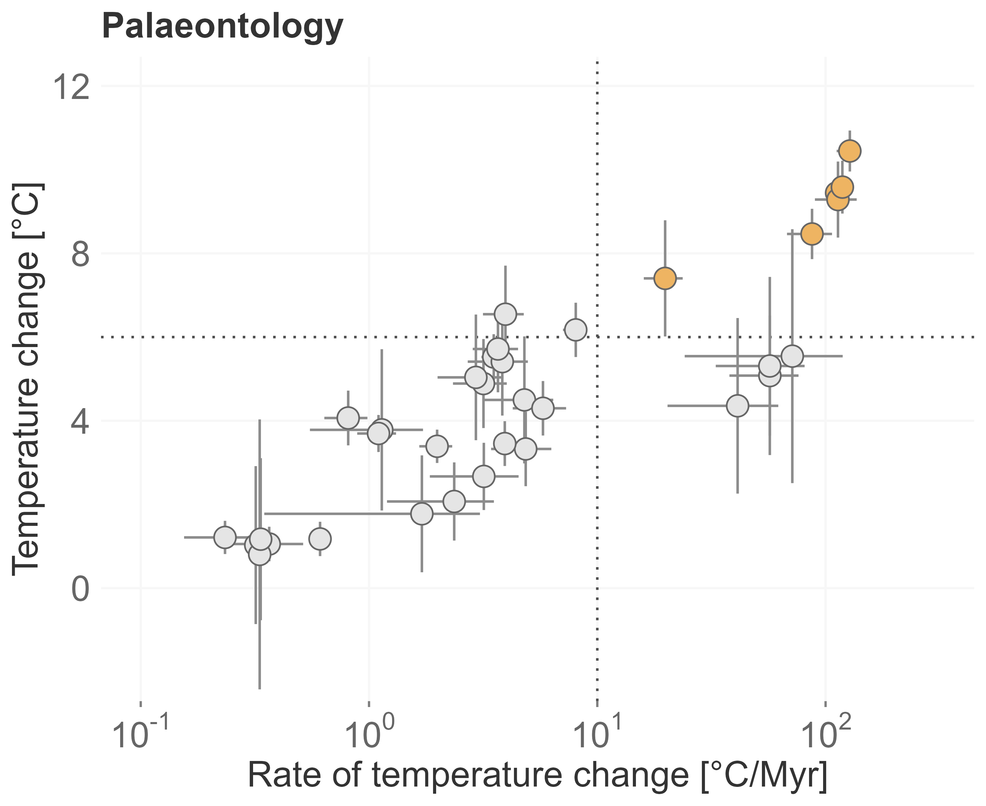
Mass extinctions
modified after Urban 2015
modified after Song et al. 2022

Slide 4
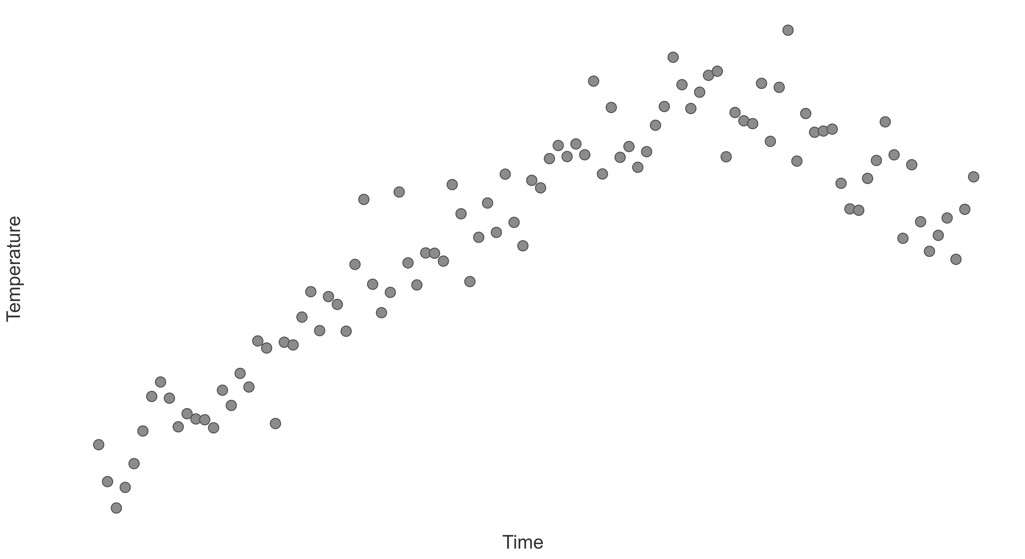
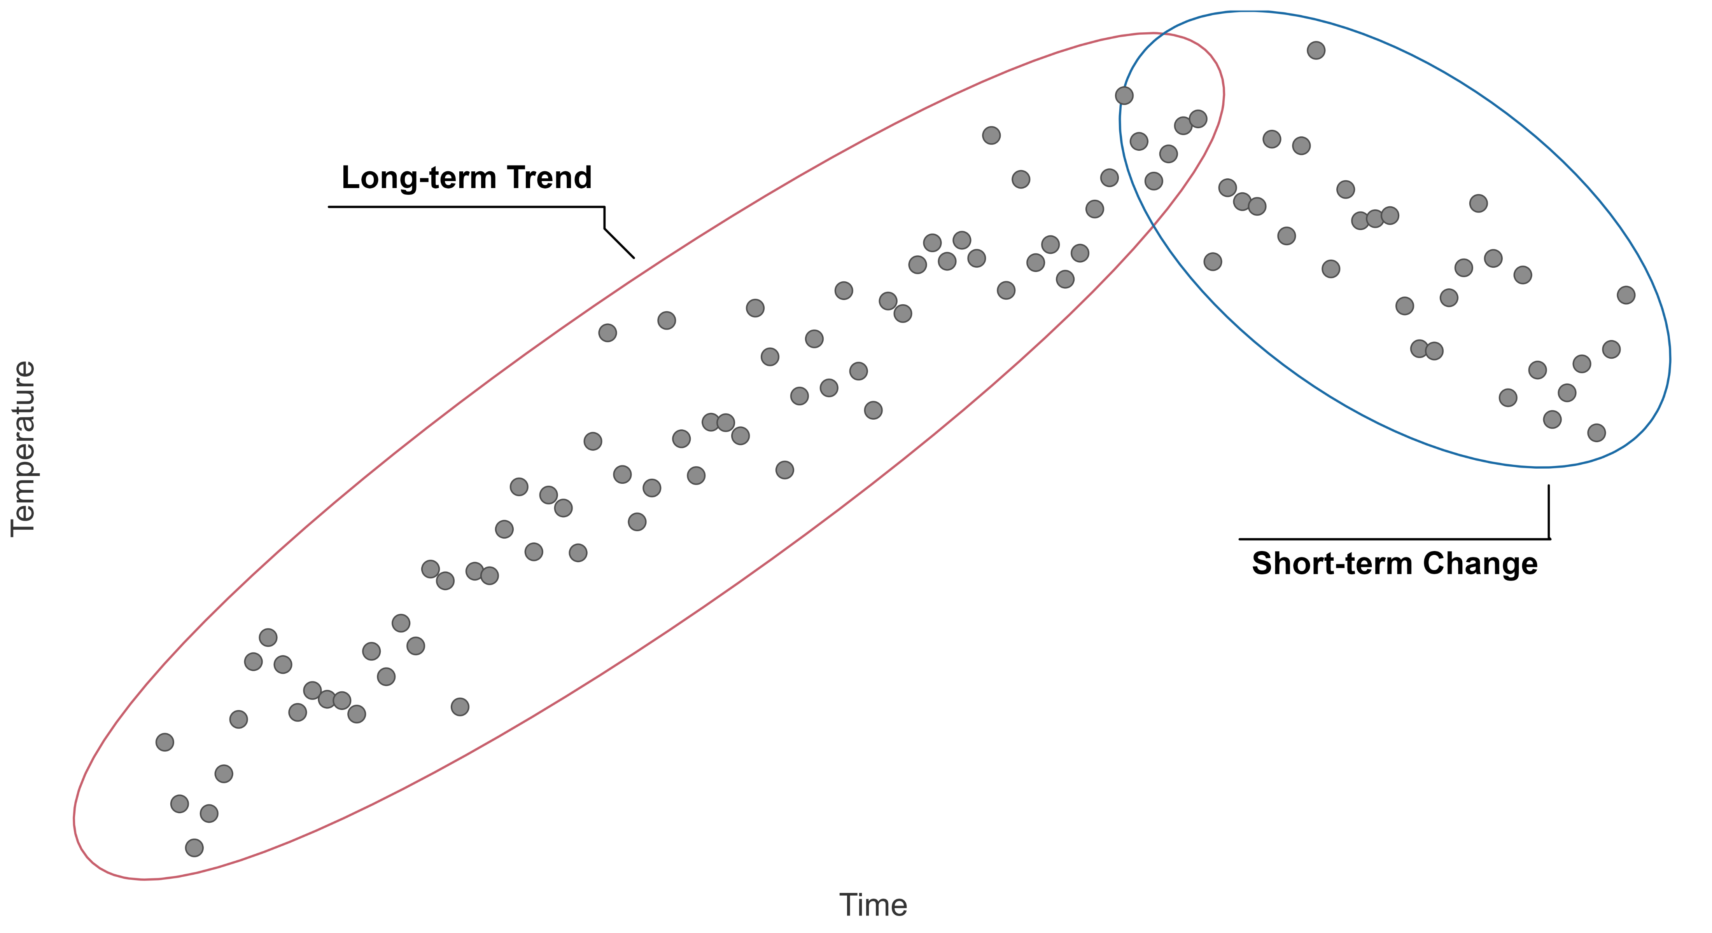
Temporal context

Slide 5






Temporal context matters
Deep-Time
Extinction risk of fossils
Origination probability of fossils
Environmental data during extinction events
Near-Time
Rate of change in terrestrial plants
Assemblage turnover in planktonic foraminifera
Implementation in conservation science
Outlook
Meta-analysis
Shark extinctions
Mathes et al. 2021, Nature Ecology and Evolution
Mathes et al. 2021, PNAS
Joachimski et al. 2022, Geology
Mathes et al. 2023, in prep for resubmission
Mathes et al. 2023, in review in GEB
Flantua et al. 2023, in review in GEB

Slide 6
Niche stability
- Temperature +
Topt
Time
Performance
Tmin
Tmax
Temperature
Wiens and Graham 2005
Lieberman and Saupe 2016
Steinbauer et al. 2016

Slide 7
Niche stability
- Temperature +
Topt
Time
Performance
Tmin
Tmax
Temperature
Wiens and Graham 2005
Lieberman and Saupe 2016
Steinbauer et al. 2016

Slide 8
Climate interaction
Antagonistic
Synergistic
- Temperature +
- Temperature +
Time
Time
Synergistic
Antagonistic
- Temperature +
- Temperature +
Time
Time

Slide 9
Methodology
ΔTtrend₁
ΔTtrend₂
- Temperature +
ΔTchange
ΔTtrend₃
Time
Origination
Extinction
X
Fossil data
X
X
X
X
X
X
X
X
X
X
X
Extinction
∫_{Time}
Extinction/survival(1,0,1,0)
Model
Extinction ~ ΔTchange : ΔTtrend + (random structure)
(Frequentist or Bayesian)
Mathes et al. 2021, Nature Ecology and Evolution

Slide 10







Extinction risk
Fossil occurrences (Genera)
PaleoBio DB
NOW DB
Neptune DB
480 myr
6 myr/ 6 to 24 myr
Extinction events
δ¹⁸O isotopes

Slide 11
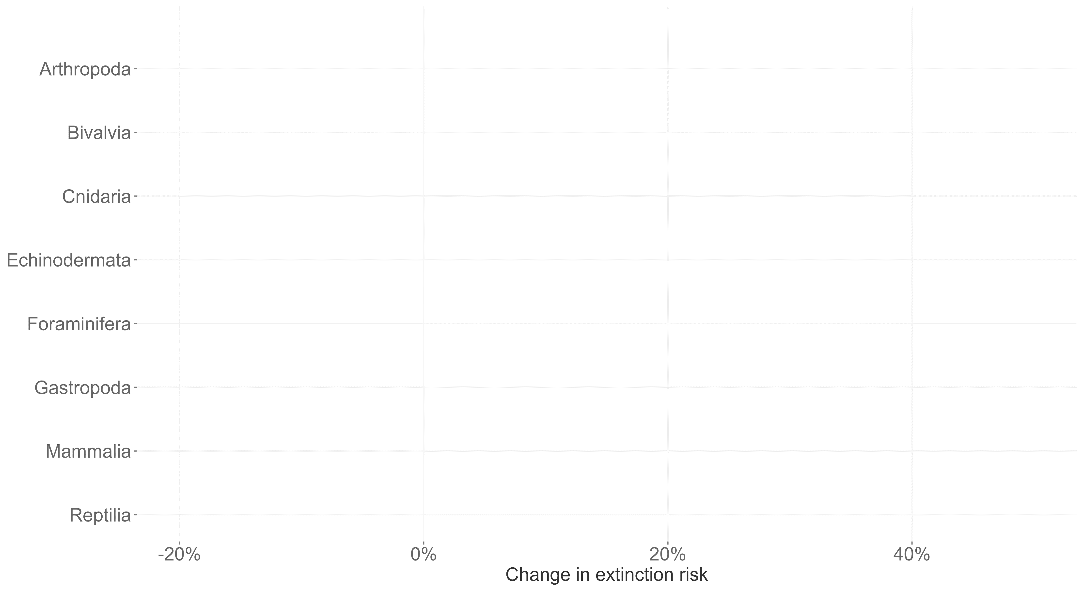
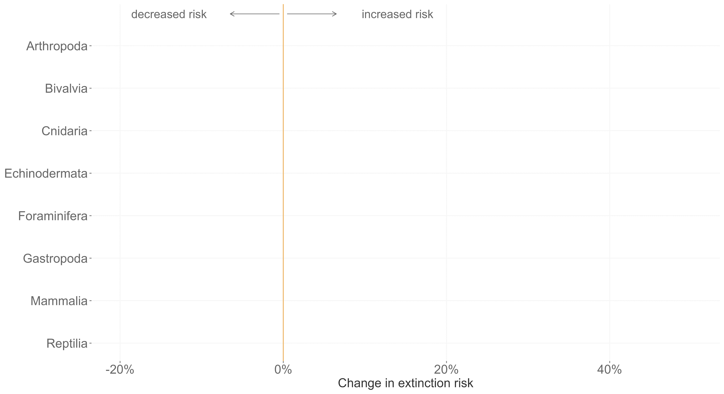
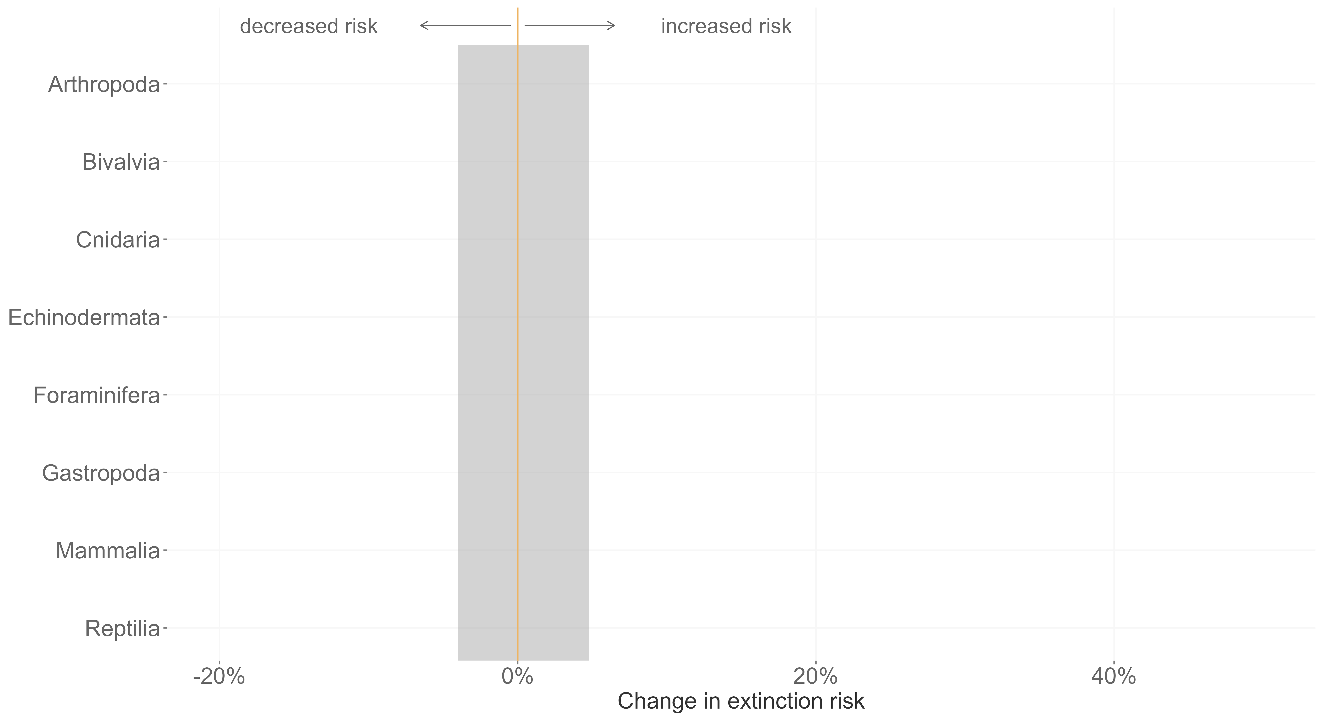
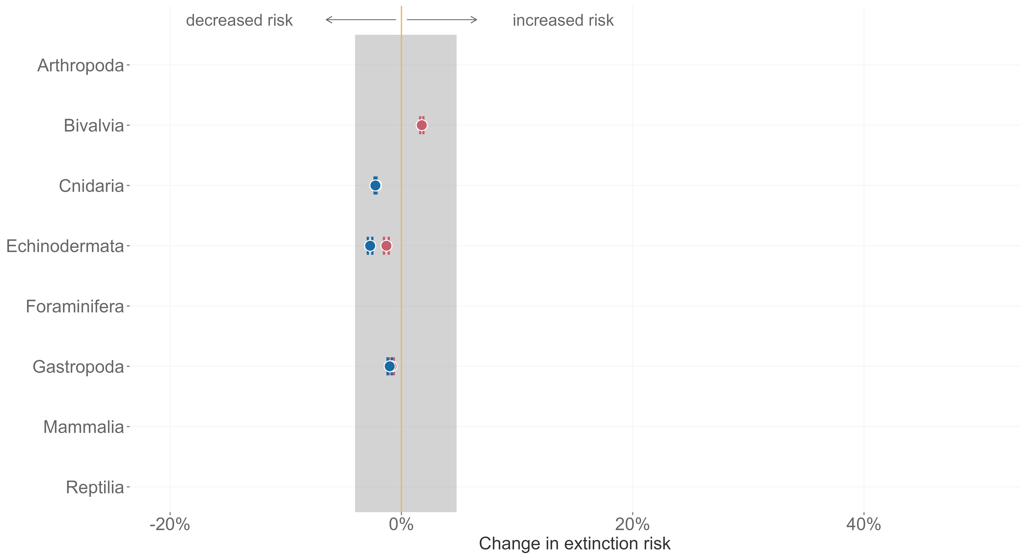
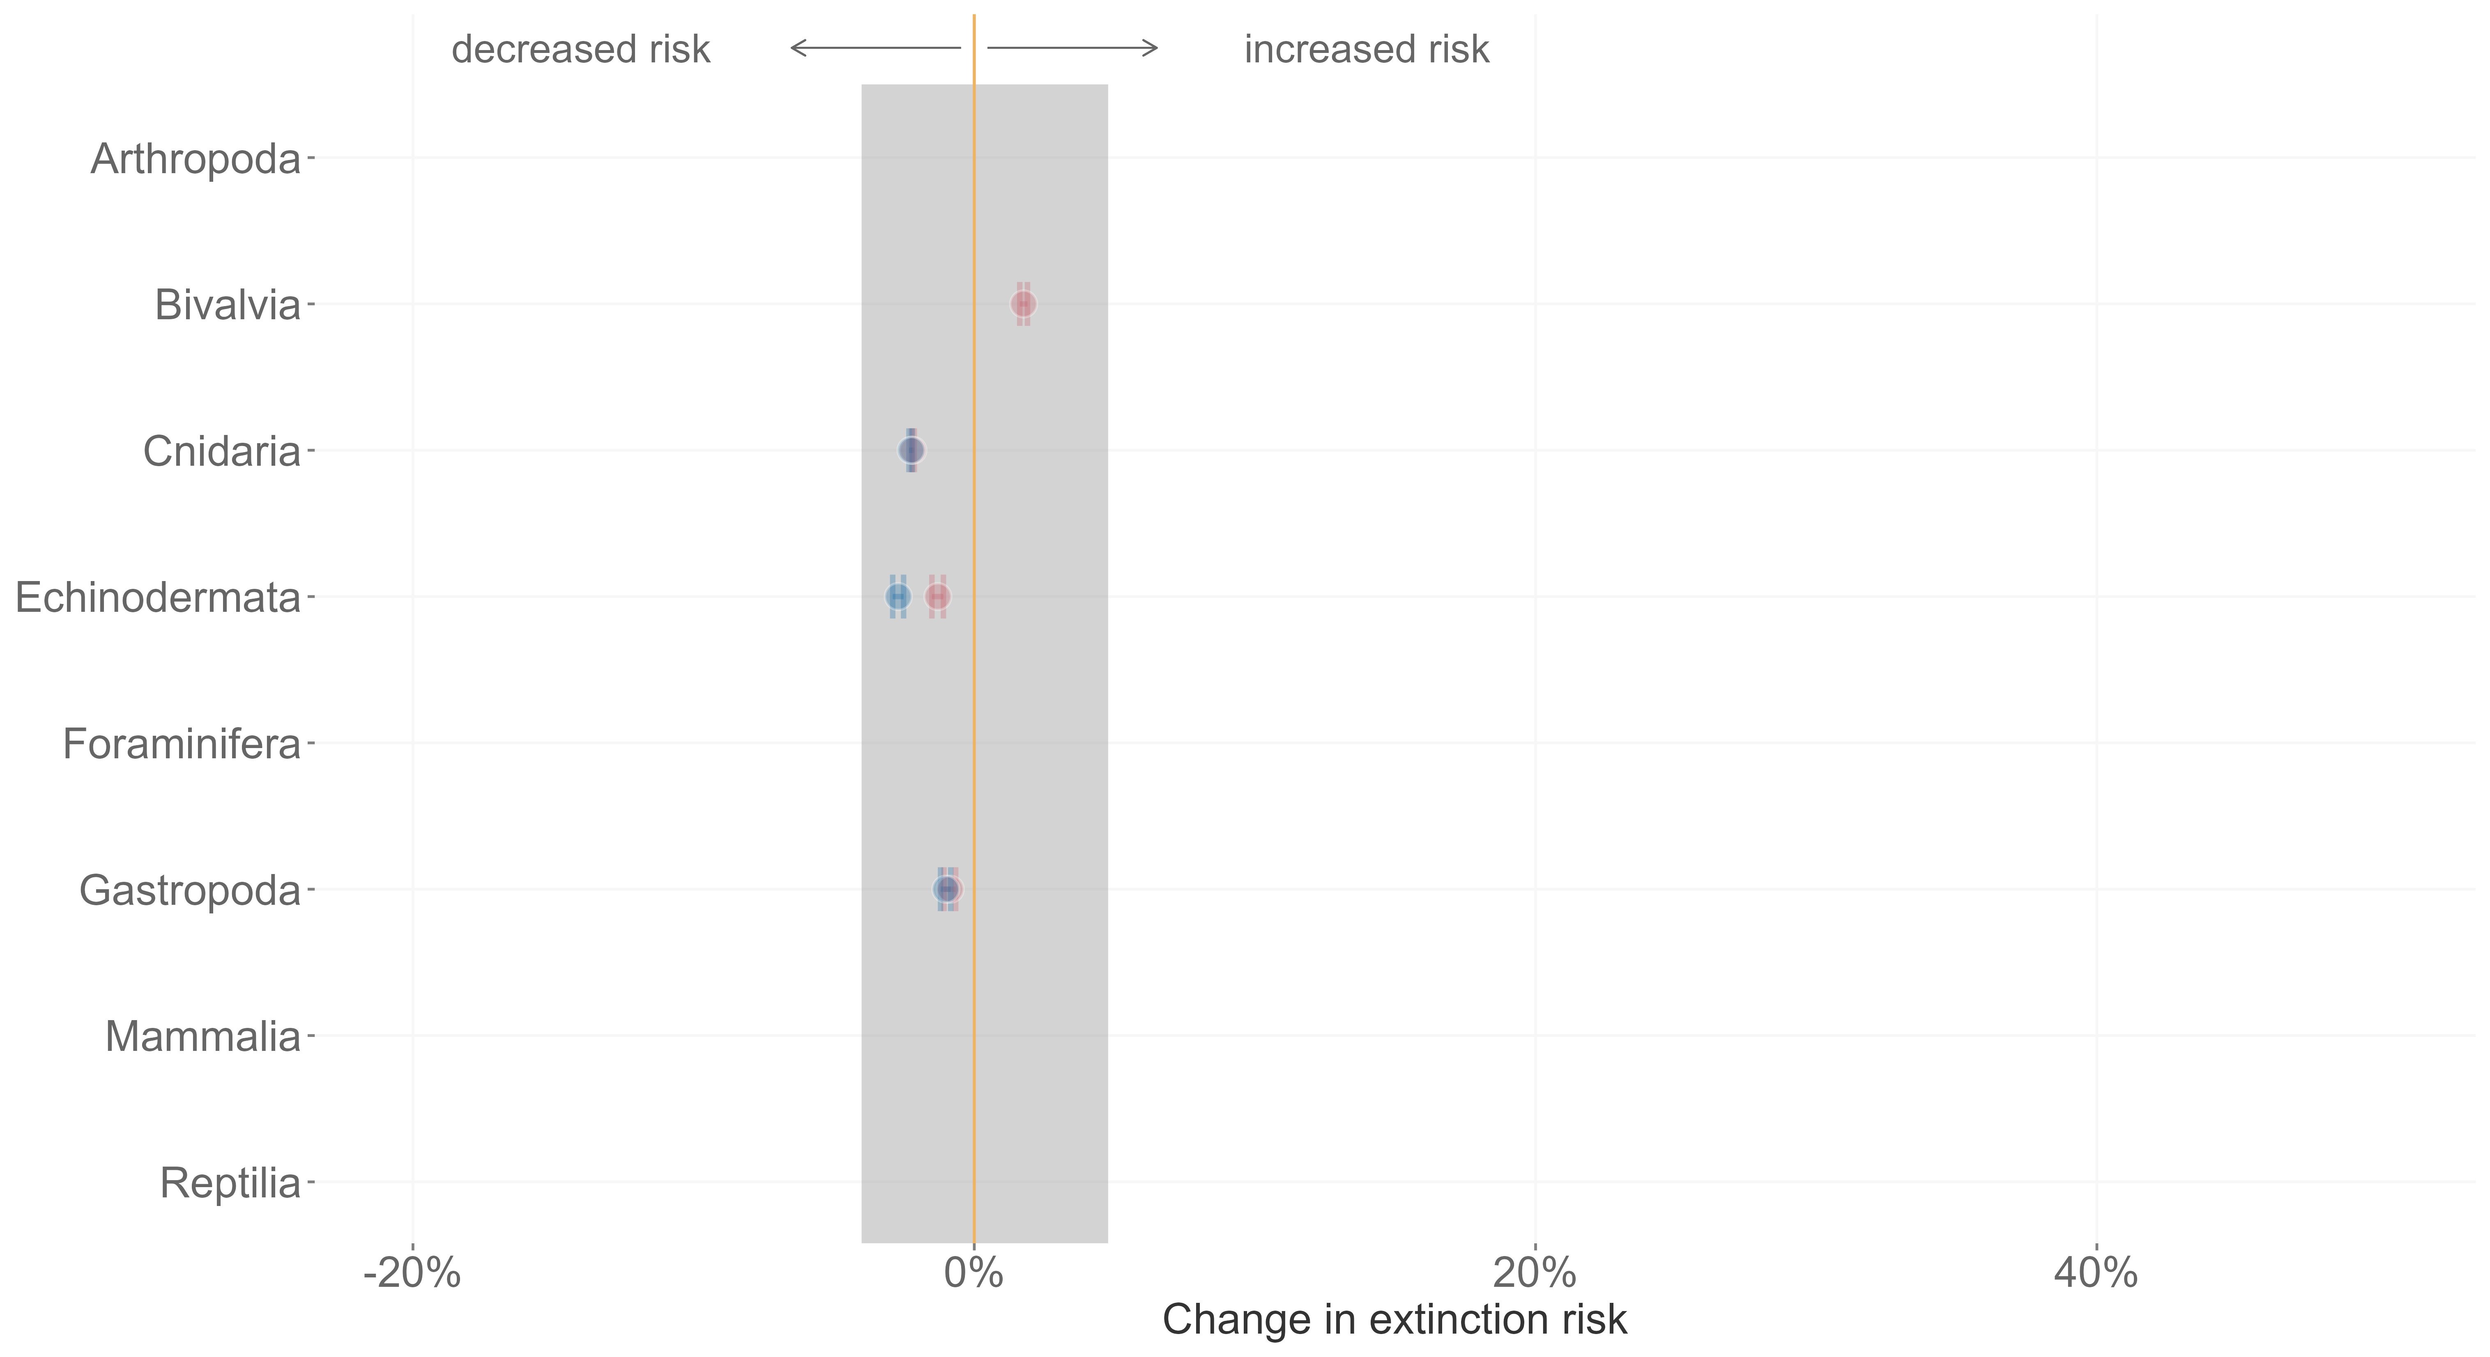
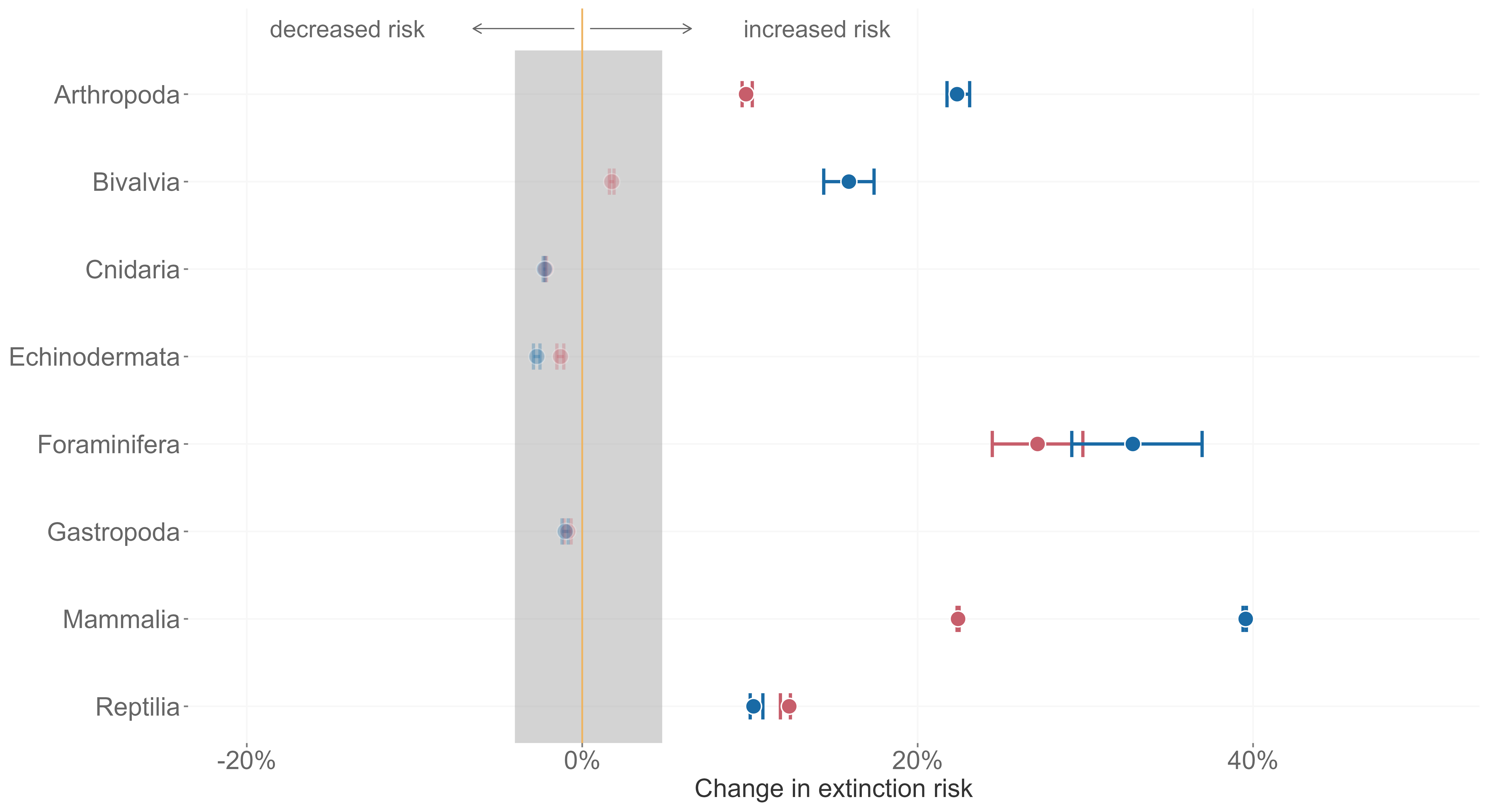







cooling-cooling
warming-warming
Mathes et al. 2021, Nature Ecology and Evolution

Slide 12
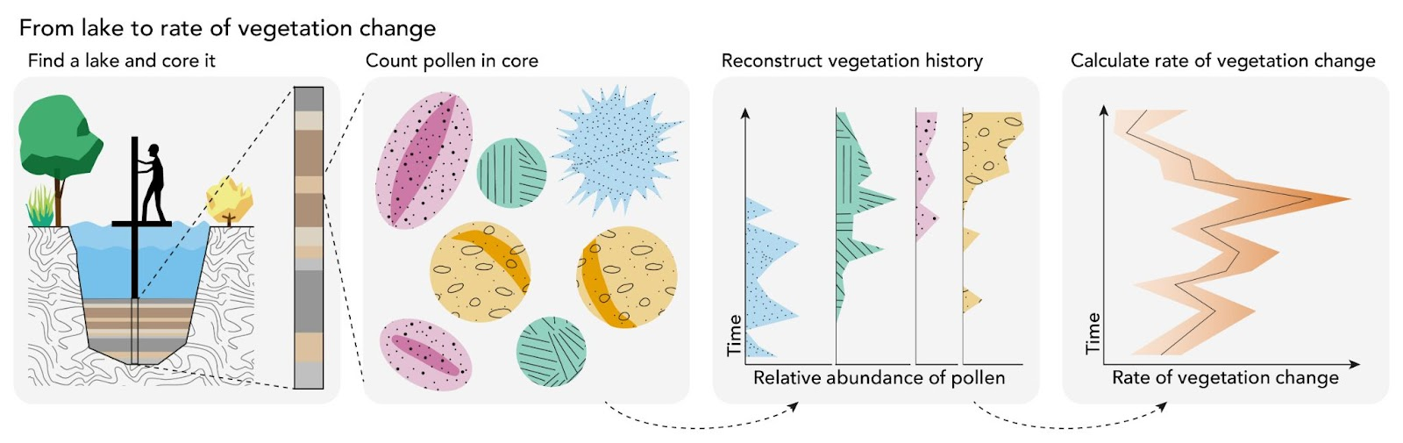
Rate of change
Neotoma DB
AOGCM
21.000 years
100 years/ 100 to 1,000 years
Artwork by Milan Teunissen van Manen

Slide 13
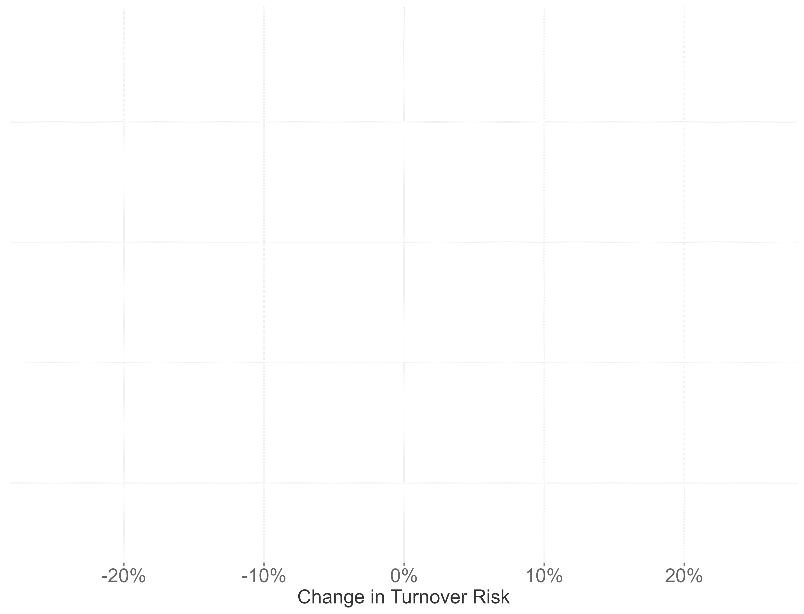
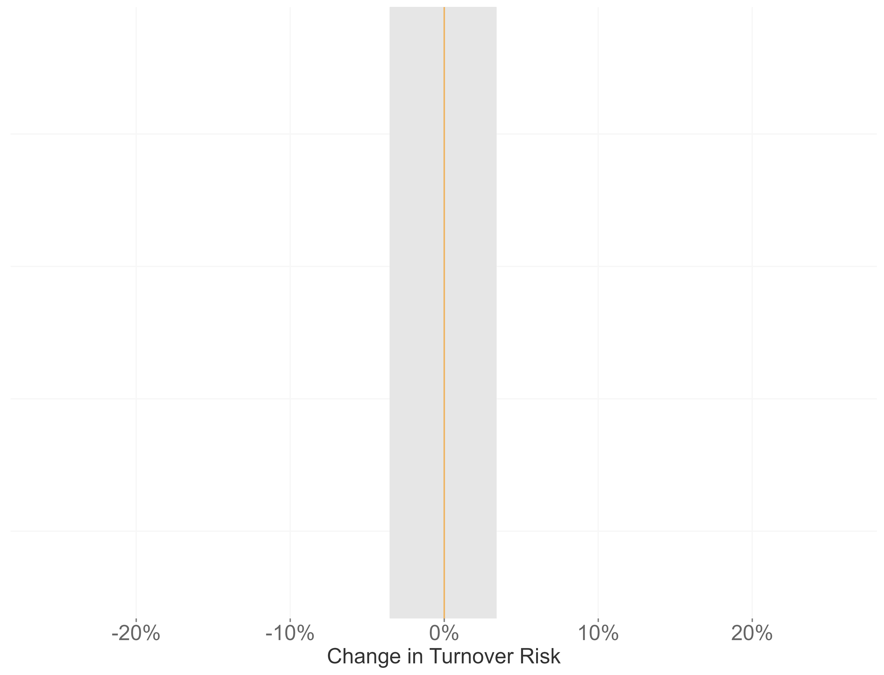
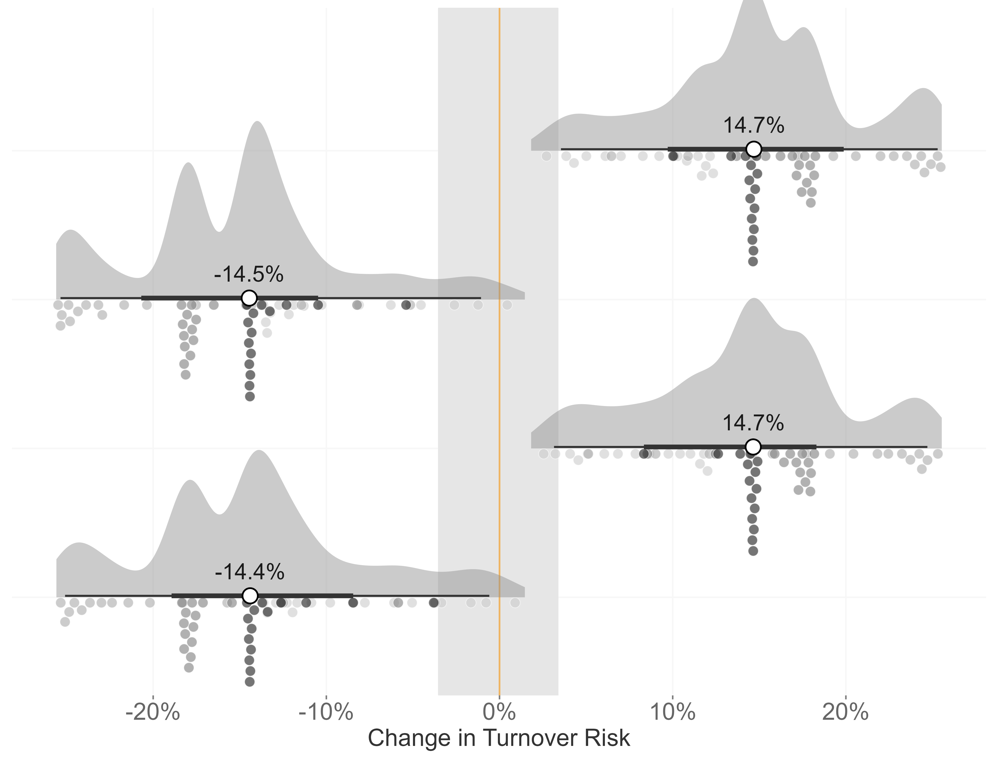
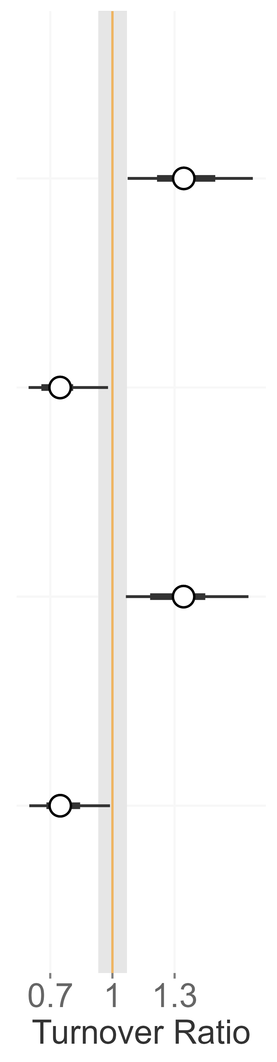
Climate Interaction
long-term
short-term
Mathes et al. 2023, in prep for resubmission

Slide 14
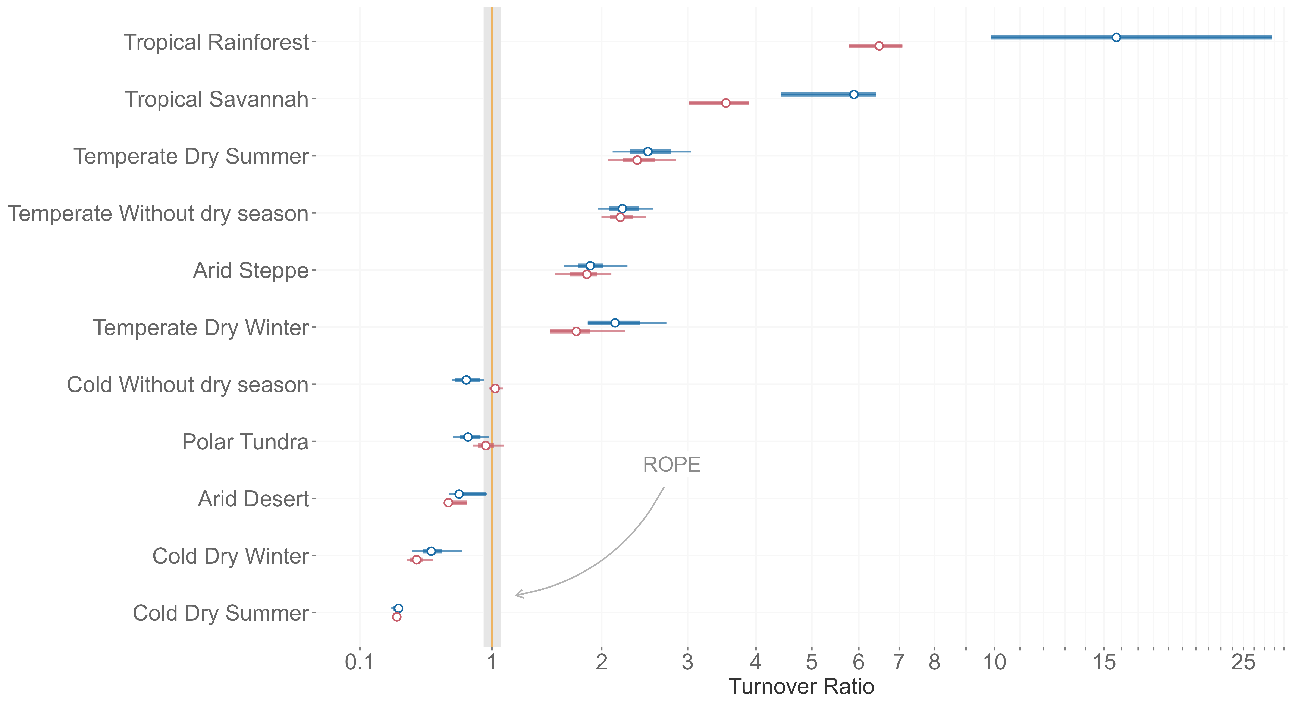
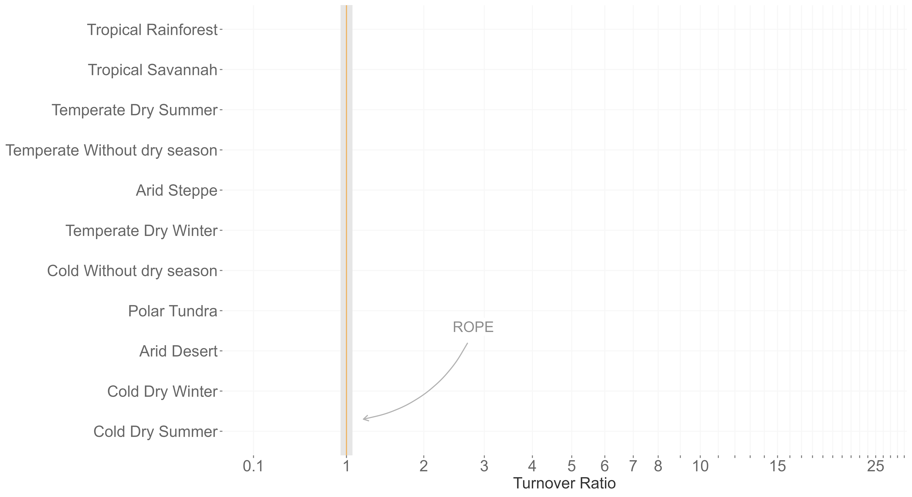
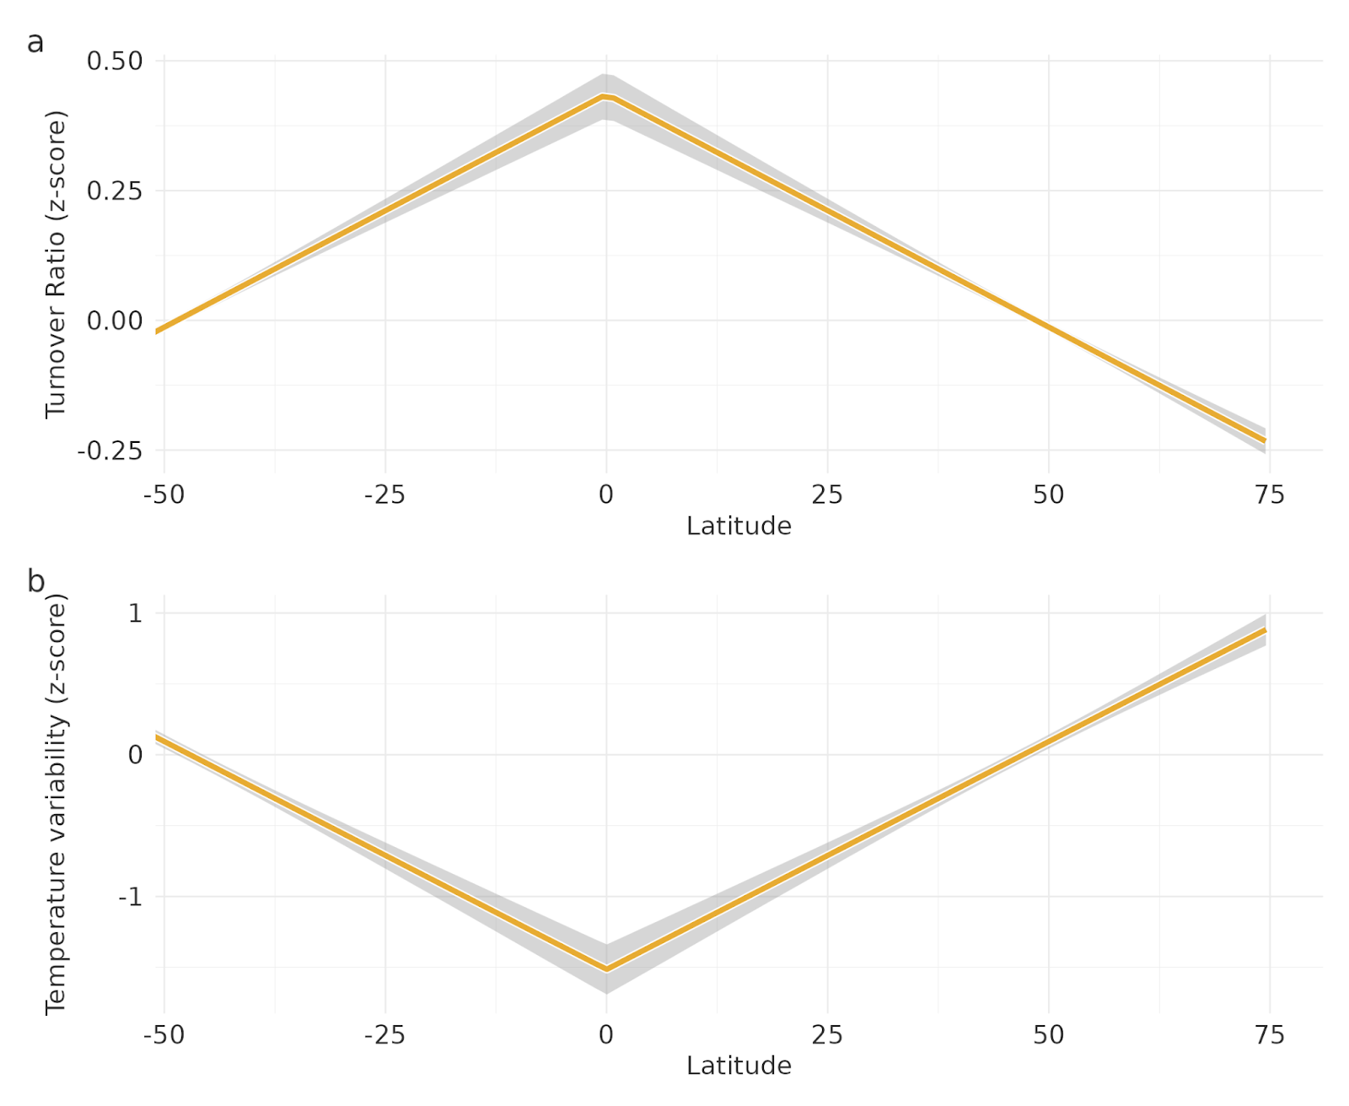
cooling-cooling
warming-warming
1
0
Temp. variability
-1
-50
-25
0
25
50
Latitude

Slide 15
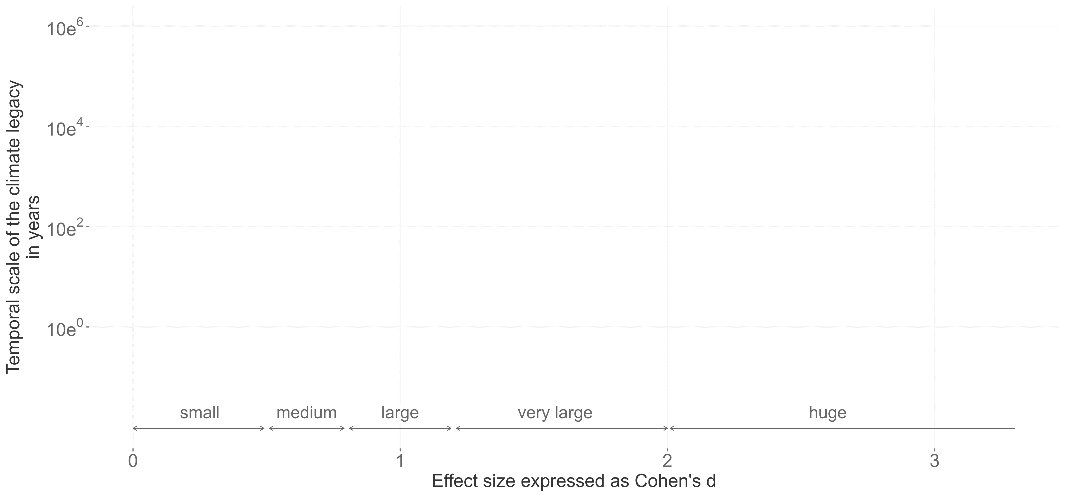
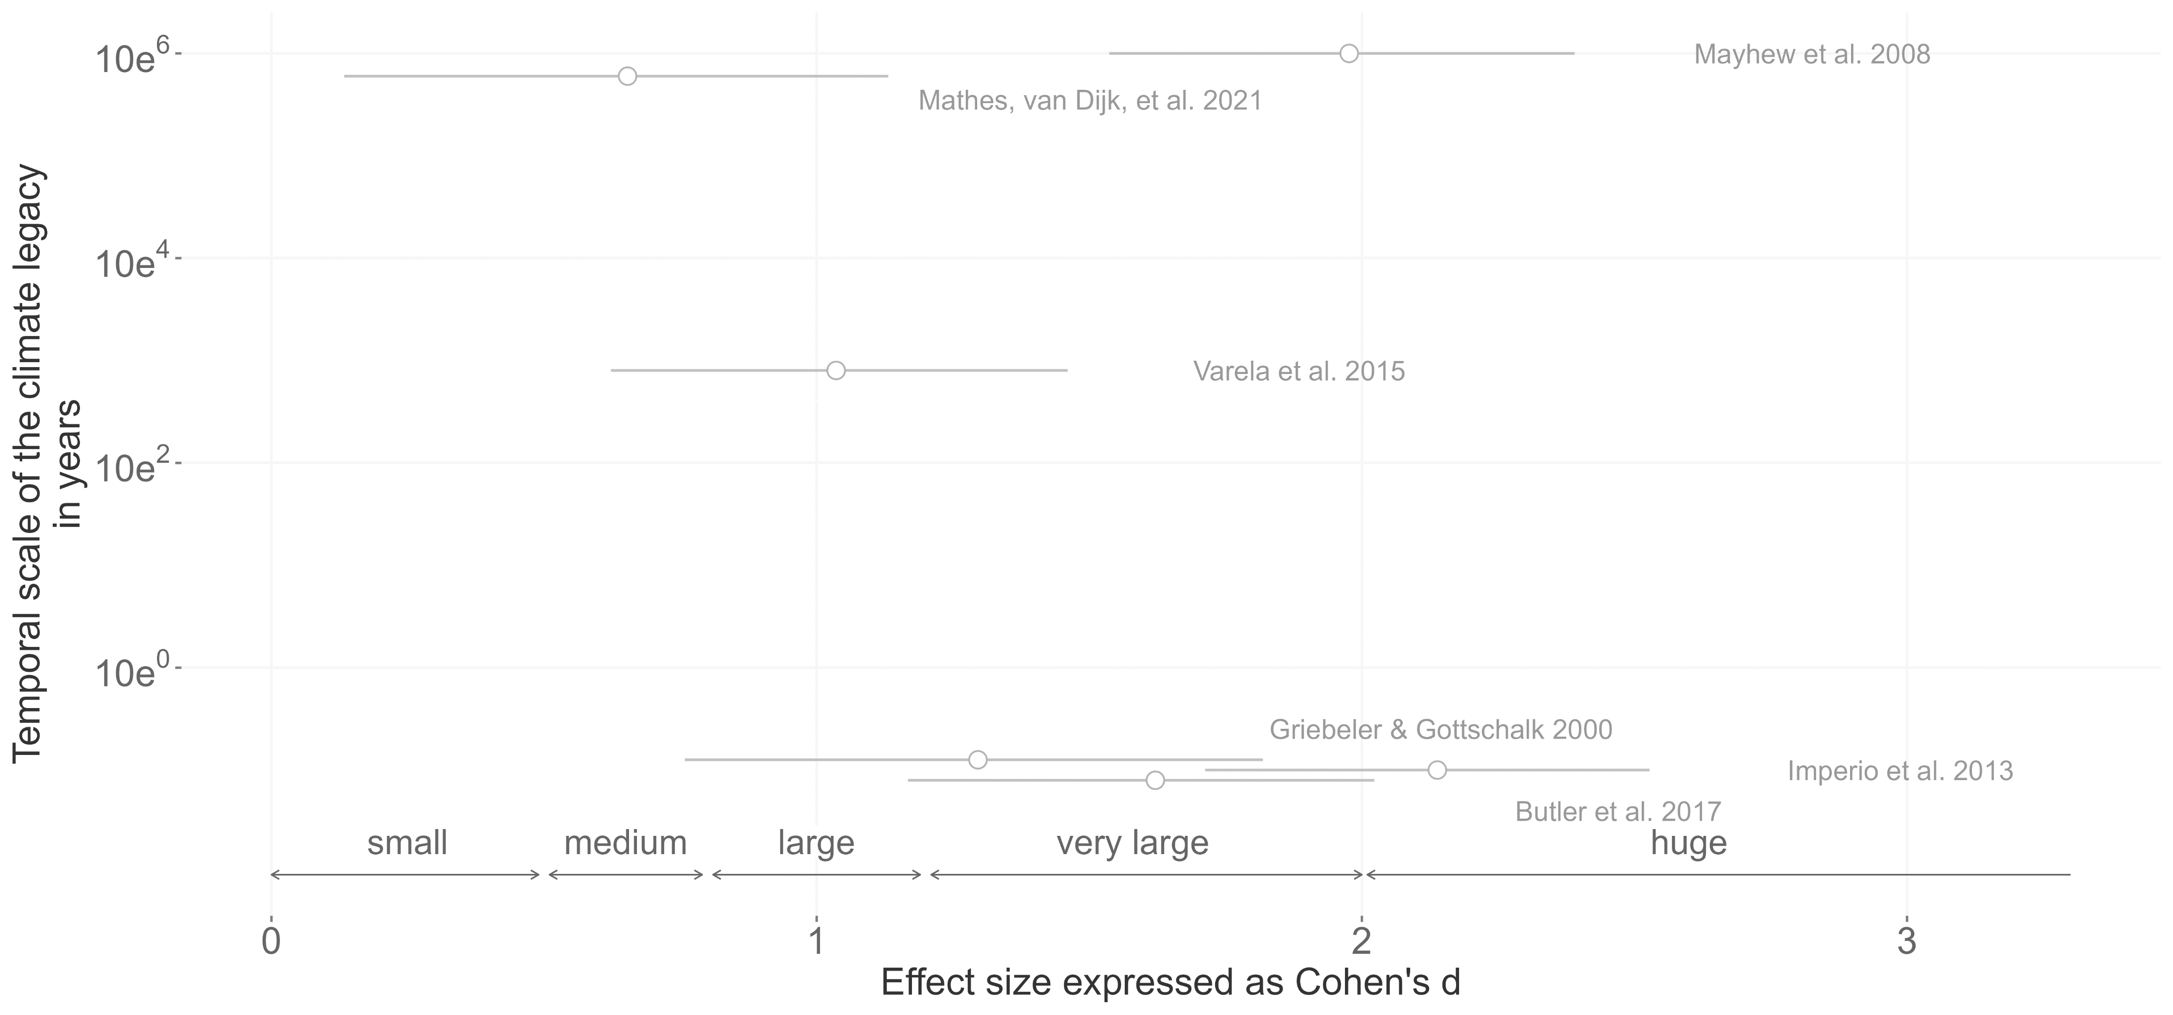
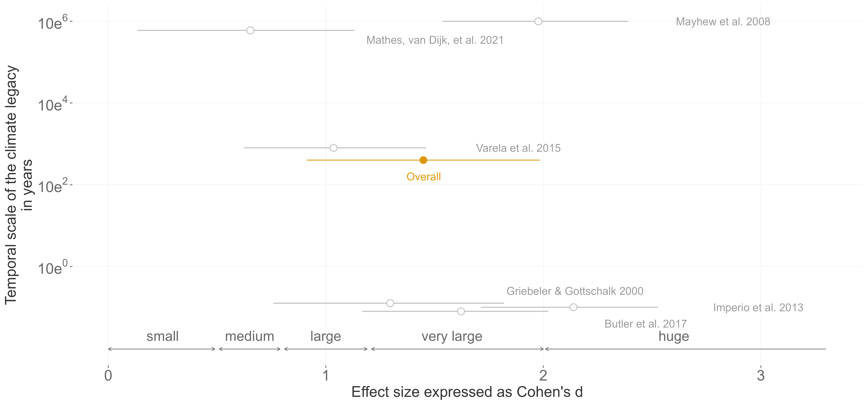
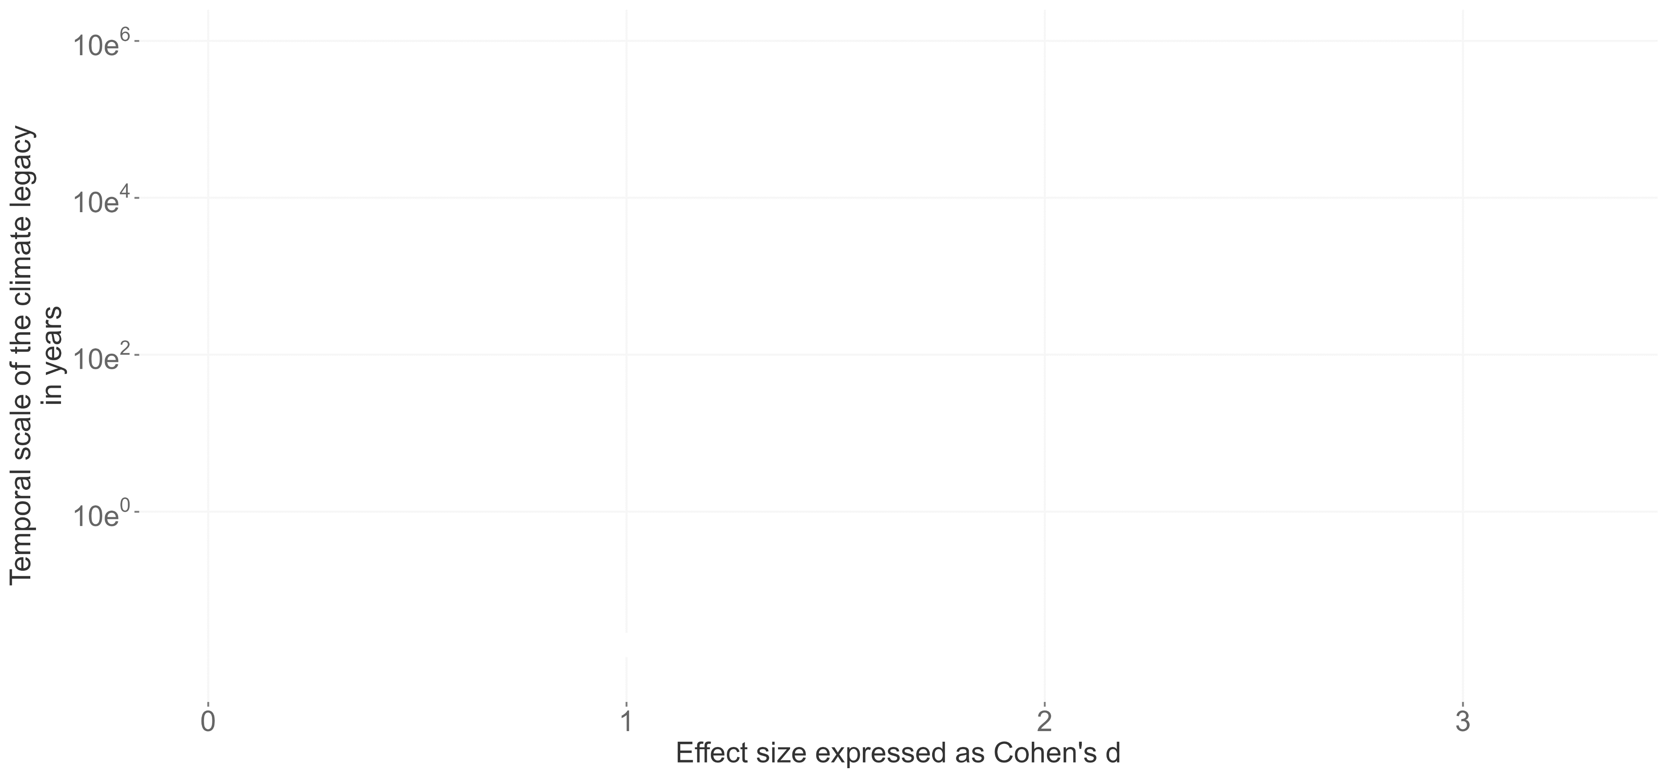
Meta-analysis
Climate induced extinction studies (n = 601)
systematic literature review (n = 207)
quantification of climate legacies (n = 14)
sufficient reporting (n = 6)

Slide 16
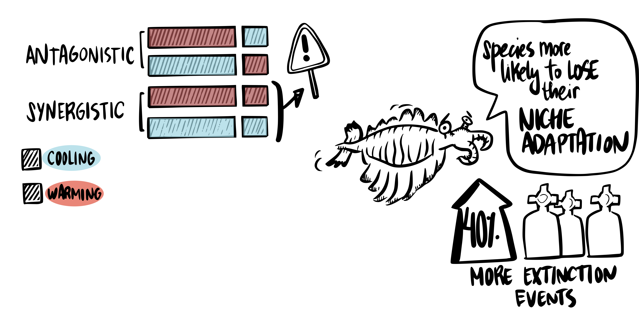
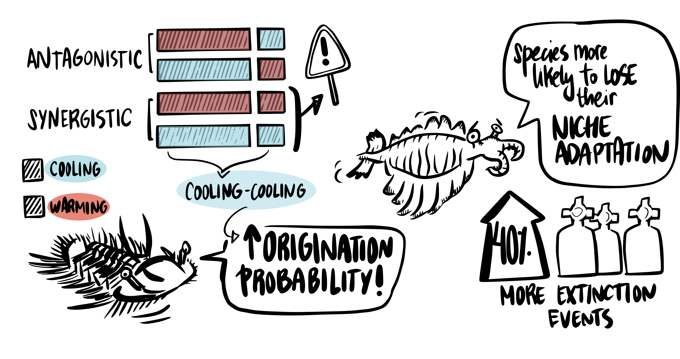

Slide 18
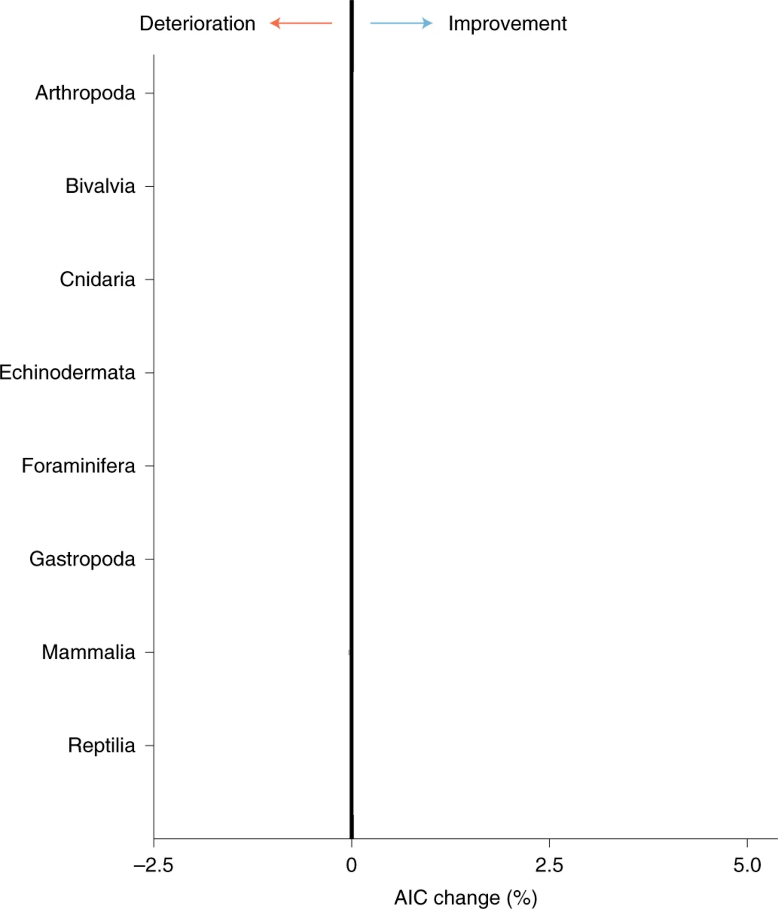
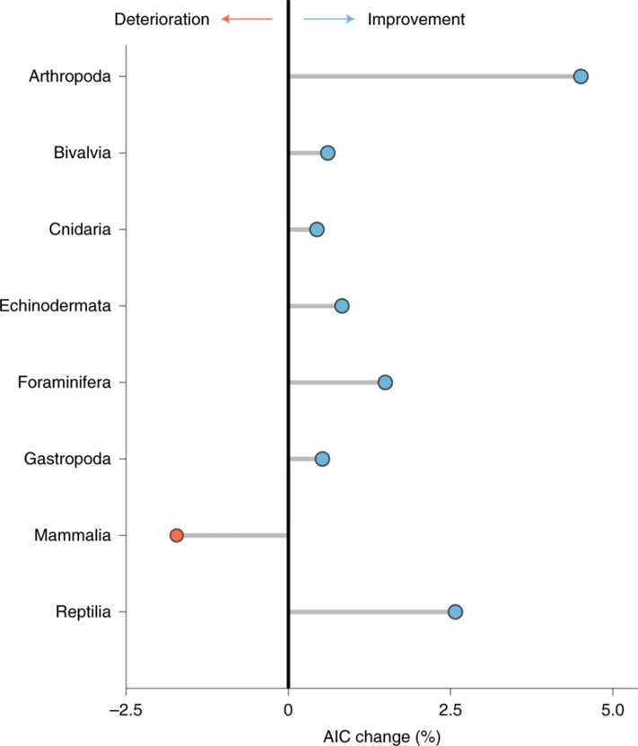
Short-term Change
Long-term Trend
Mathes et al. 2021, Nature Ecology and Evolution

Slide 19
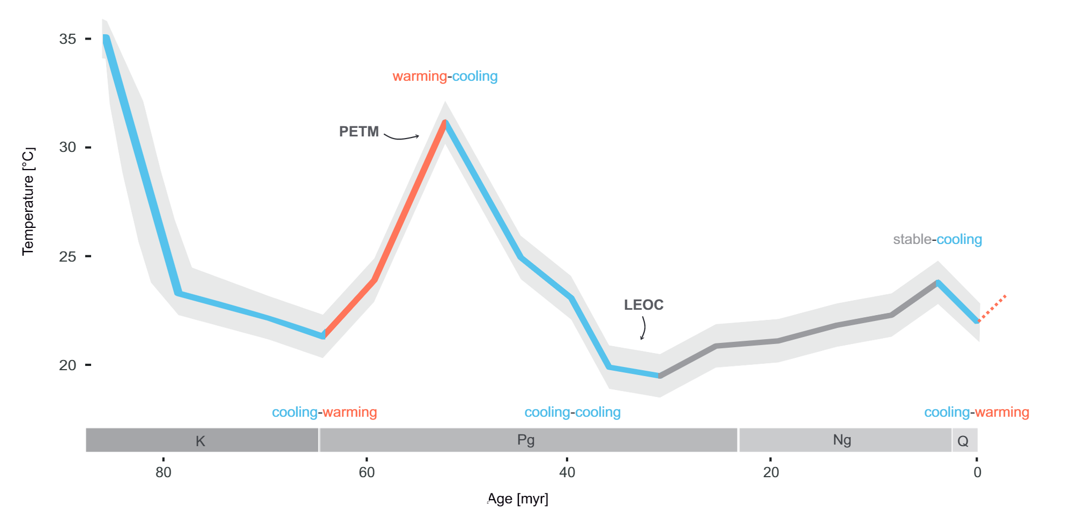

Slide 20
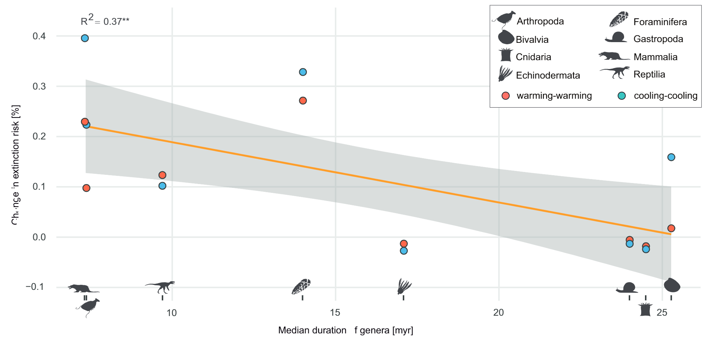

Slide 21
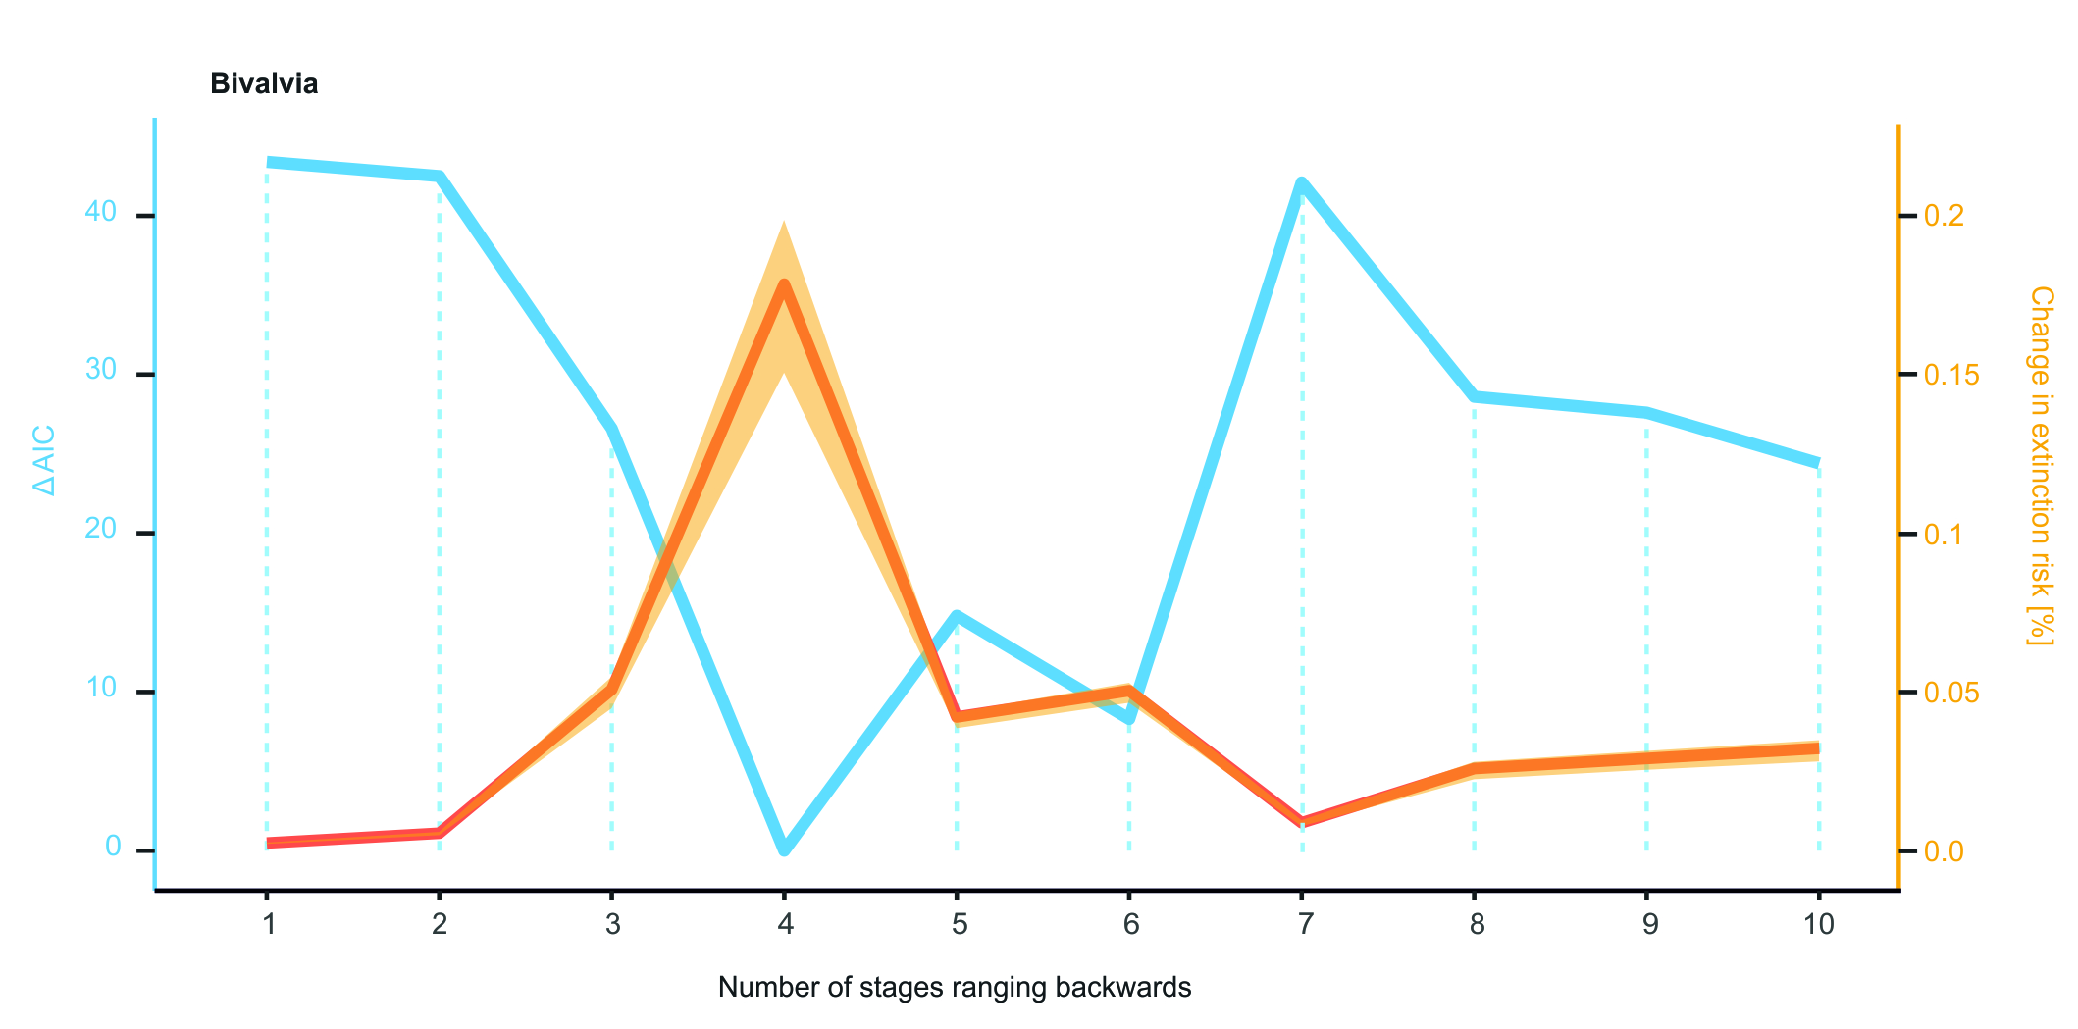

Slide 22







Origination probability
δ¹⁸O
Genera
PaleoBioDB
Marine only
Speciation events
6 million years / 6 to 24 million years

Slide 23
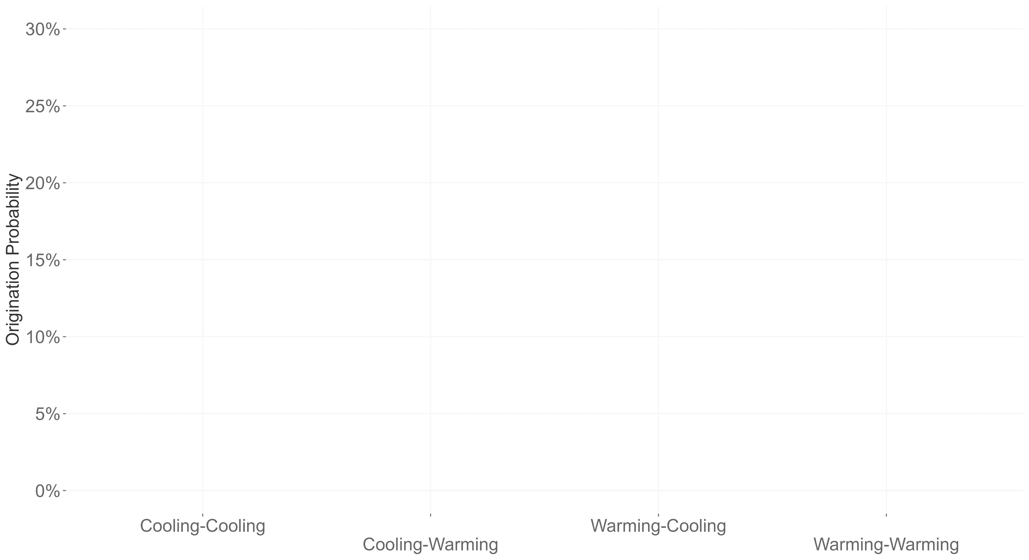
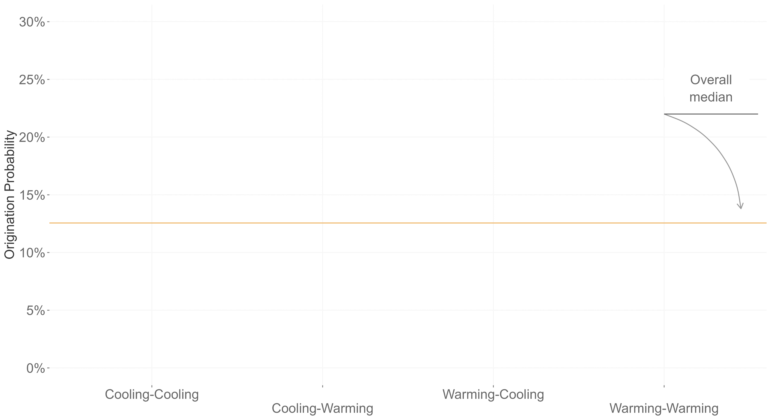
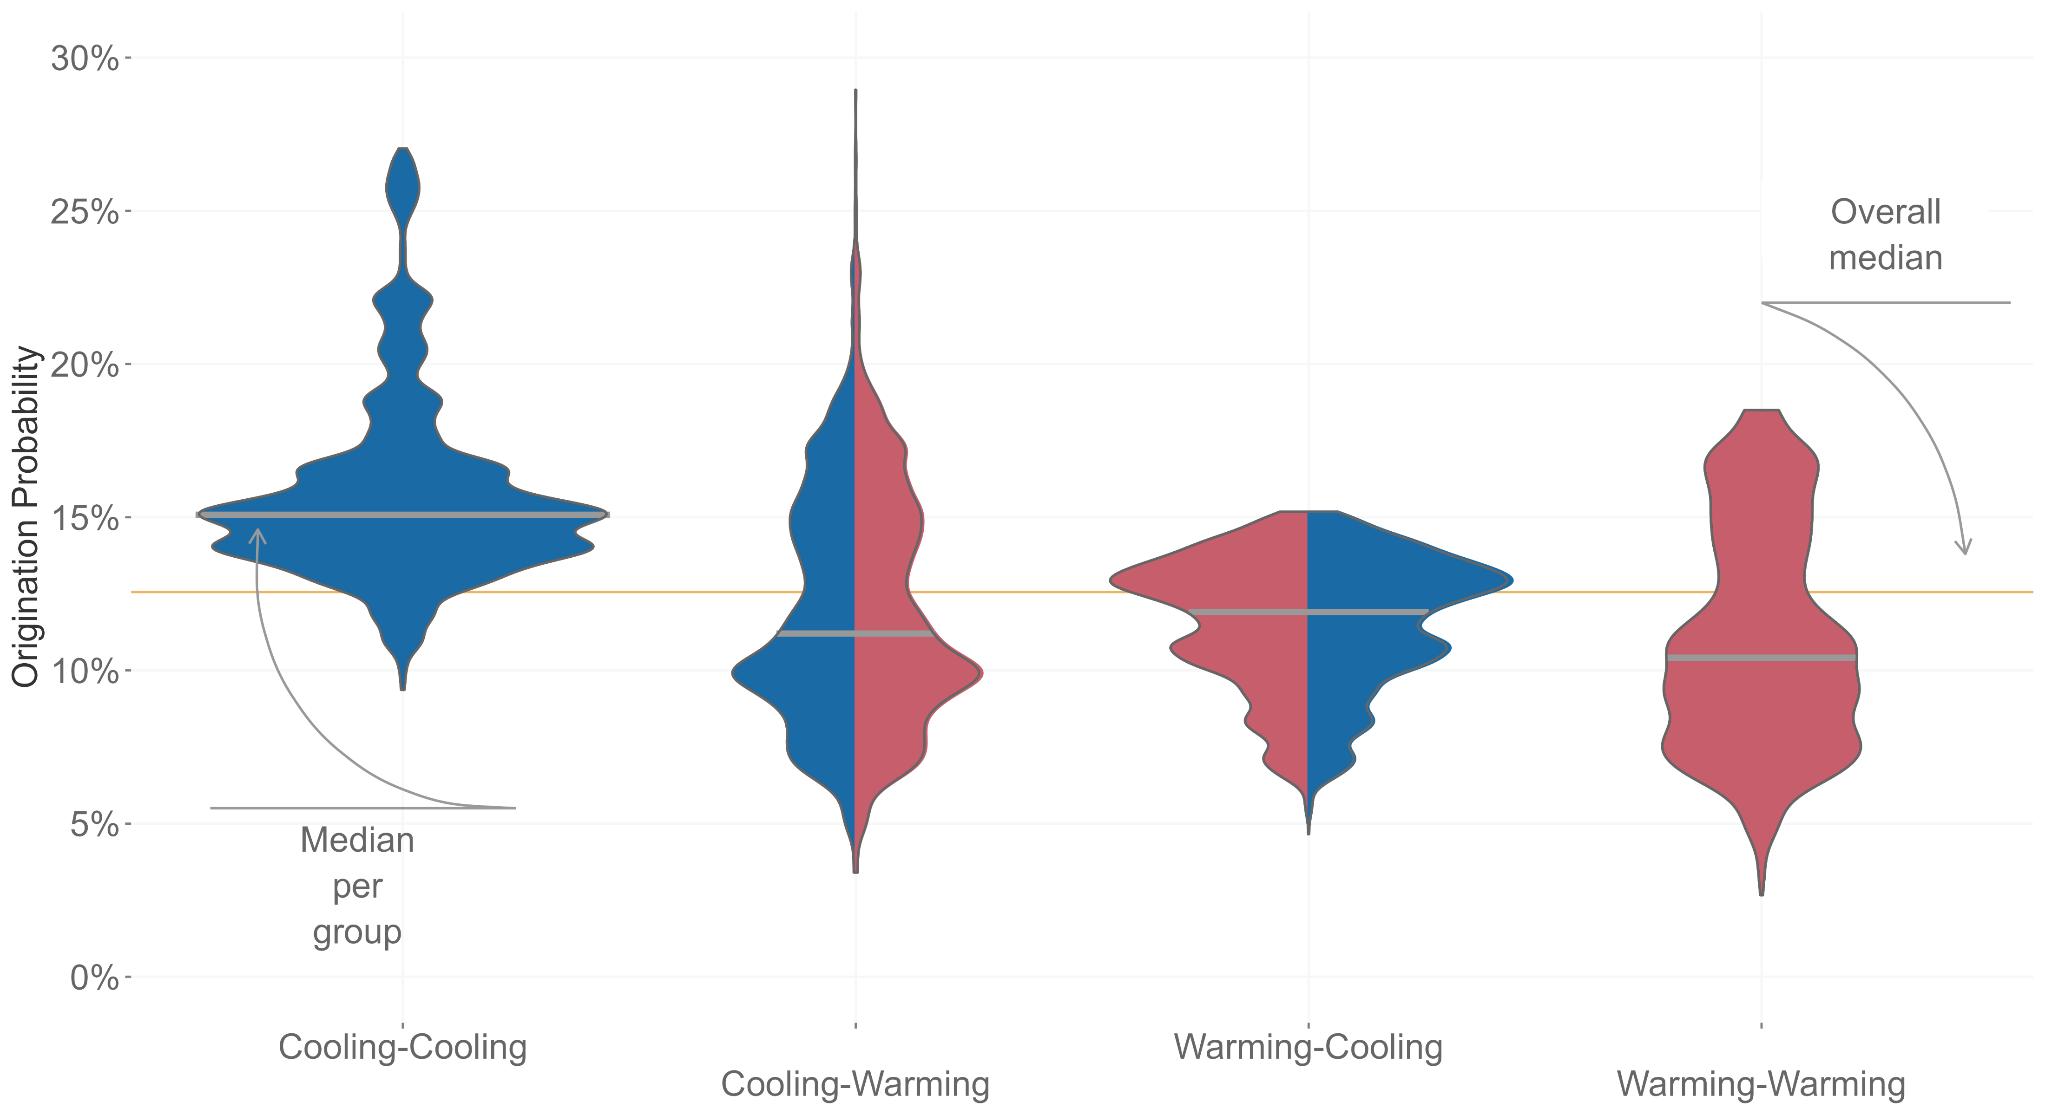
Mathes et al. 2021, PNAS

Slide 24
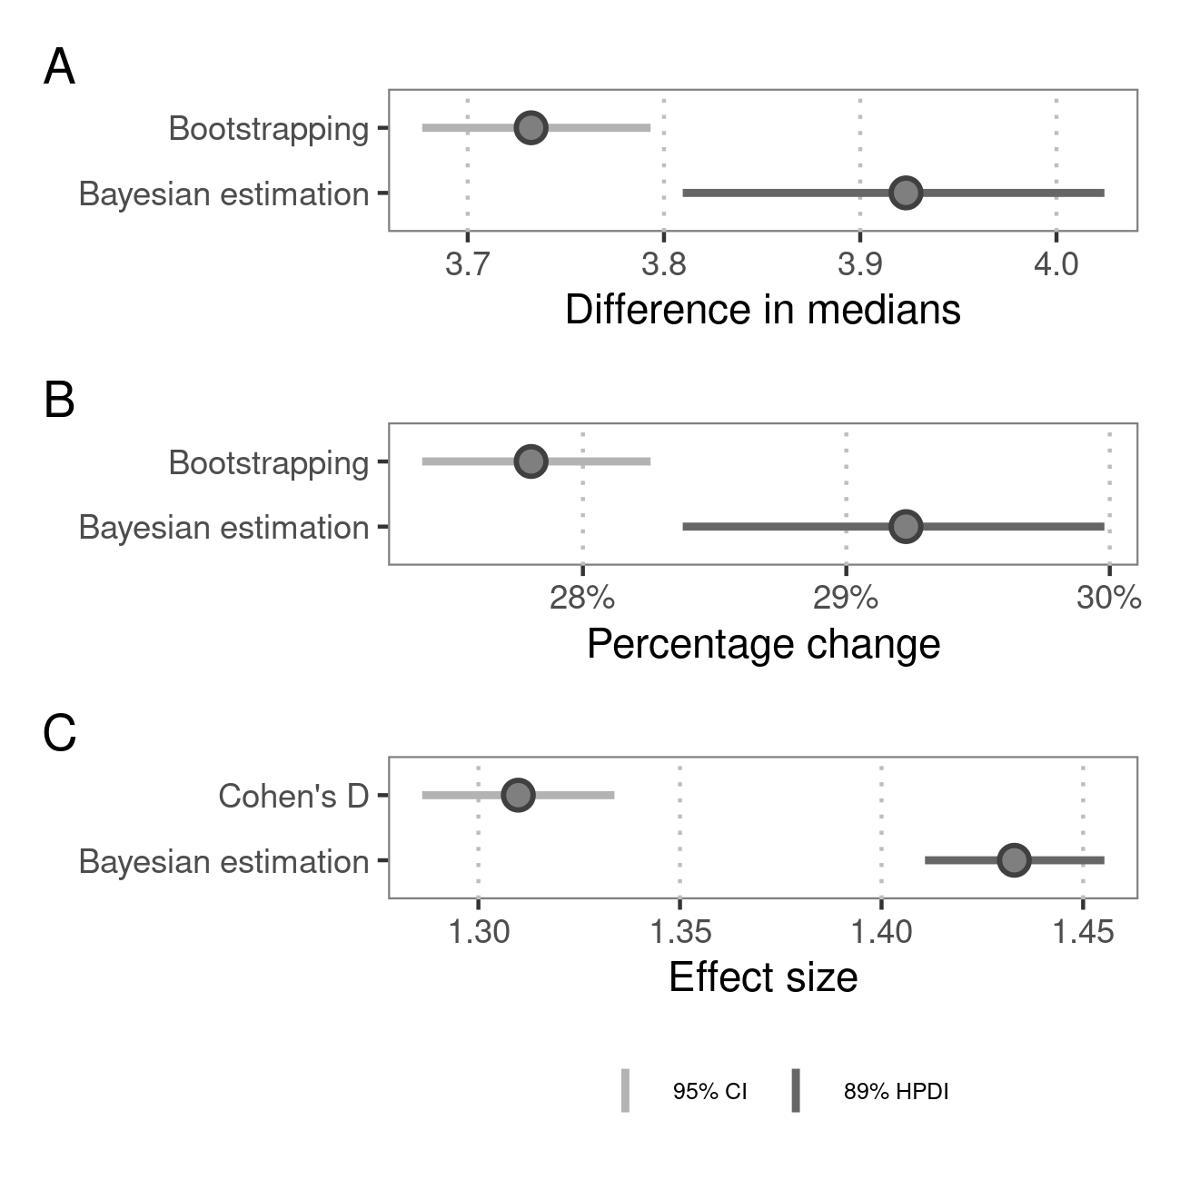

Slide 25
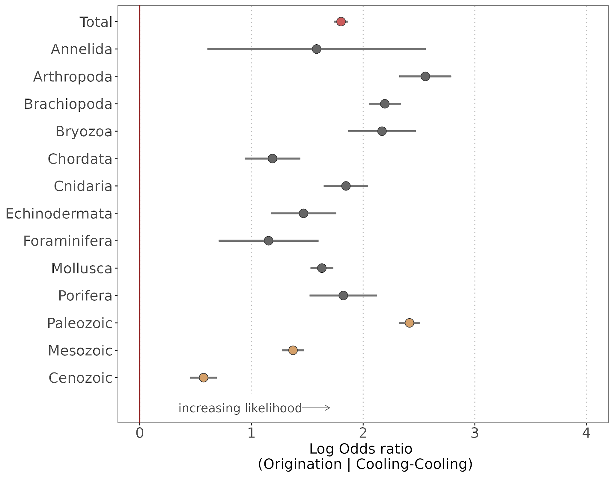

Slide 26
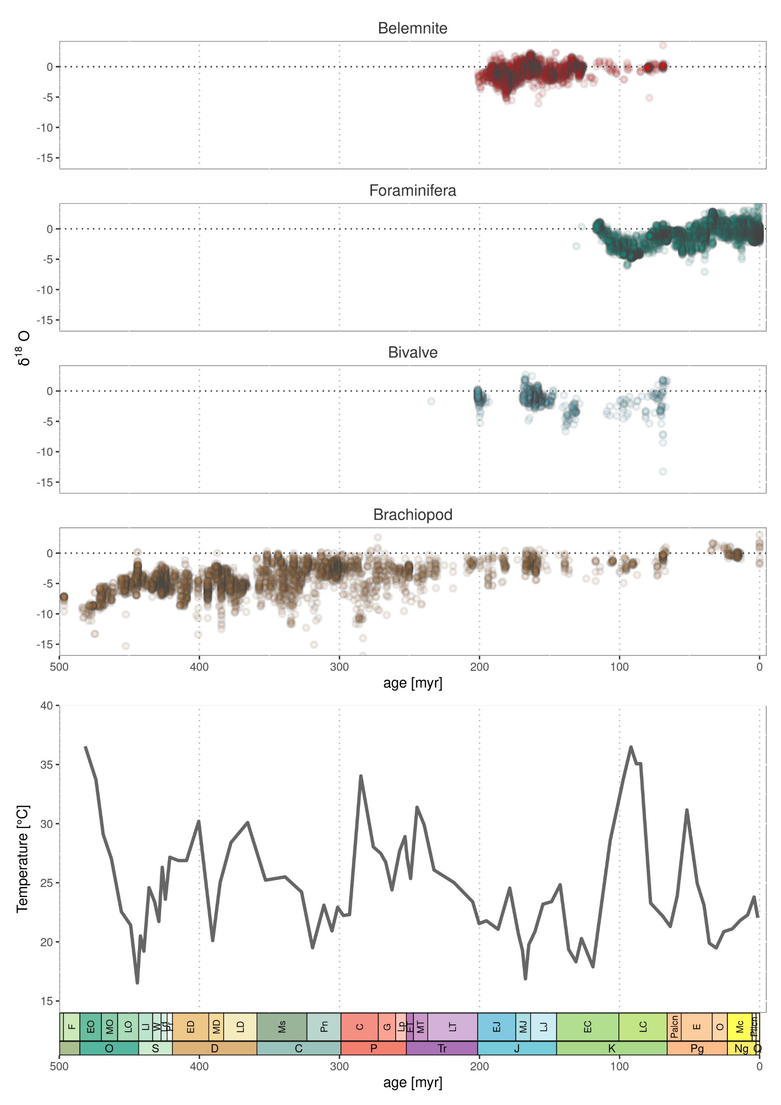

Slide 27
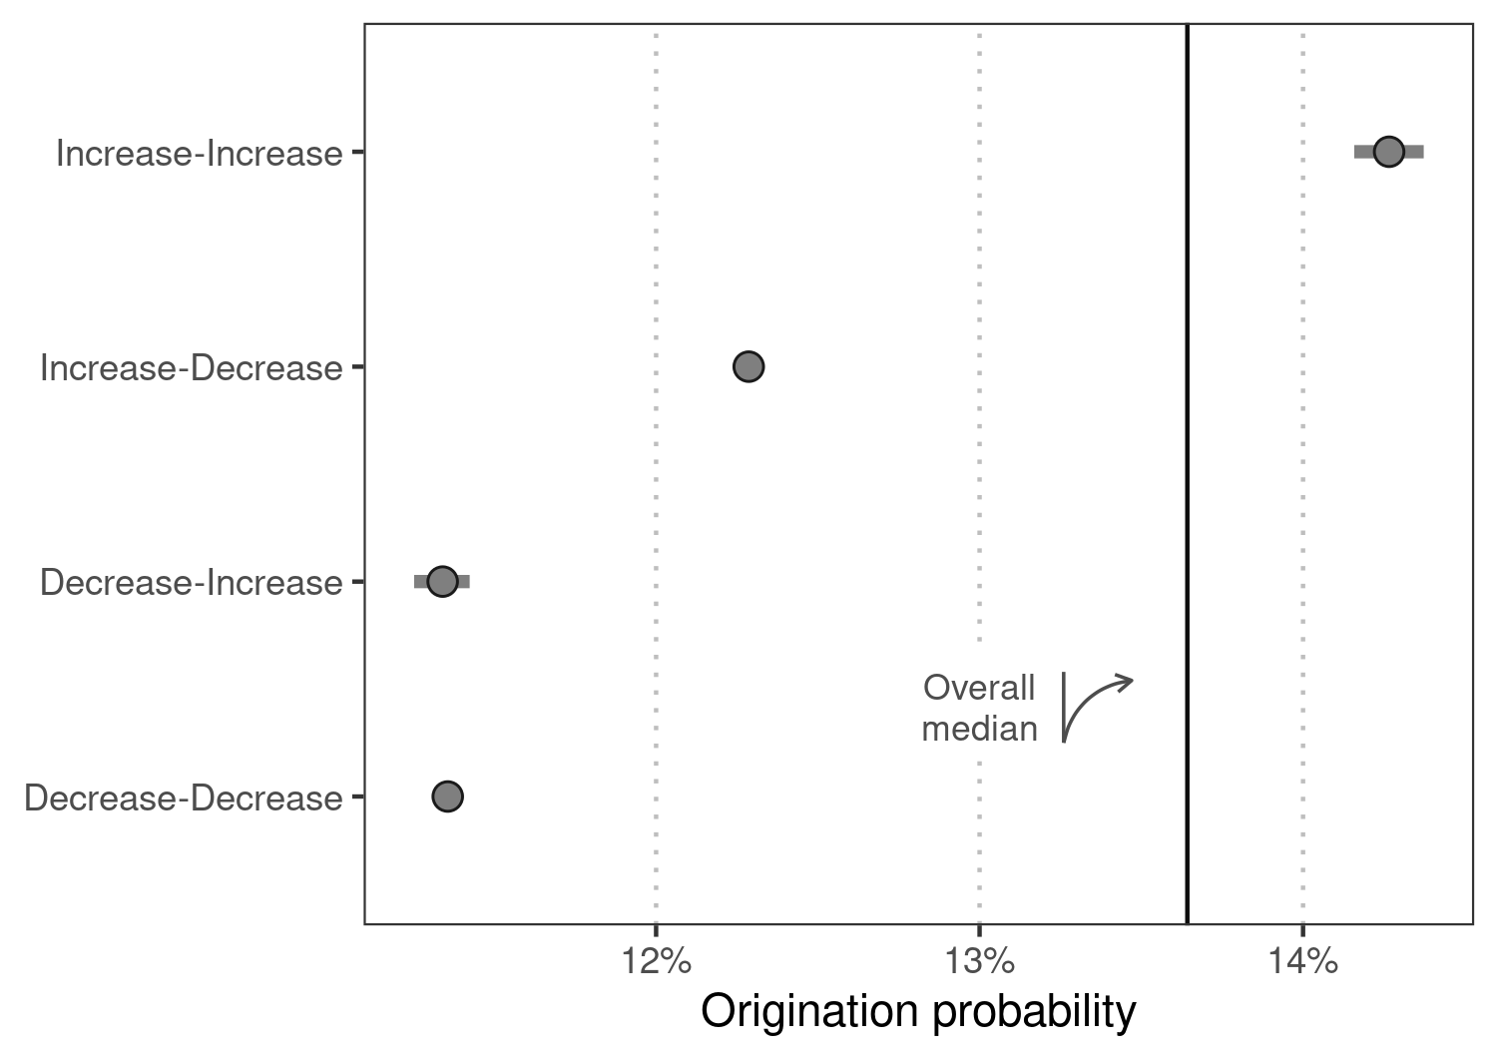

Slide 28
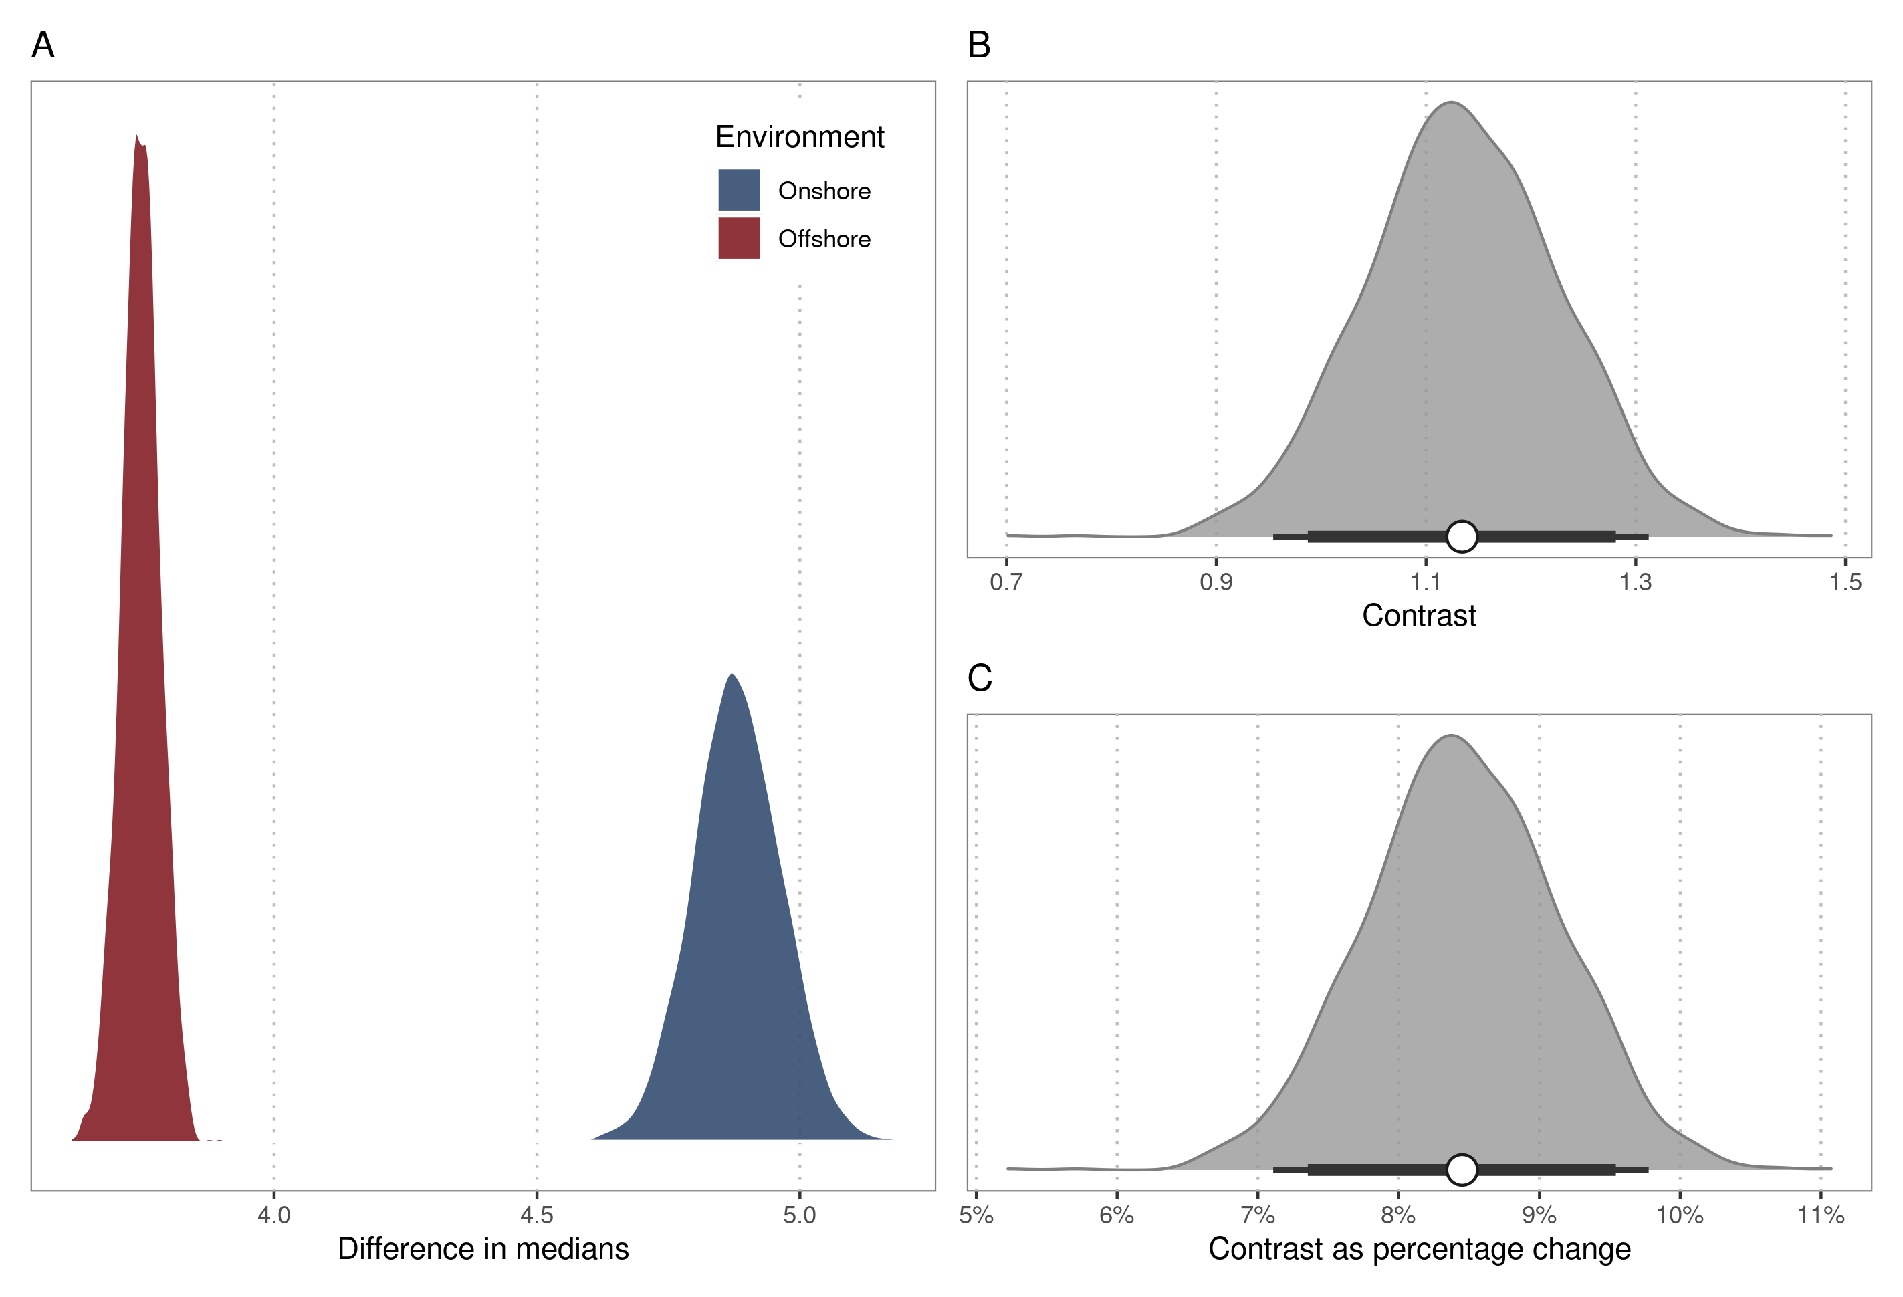

Slide 29
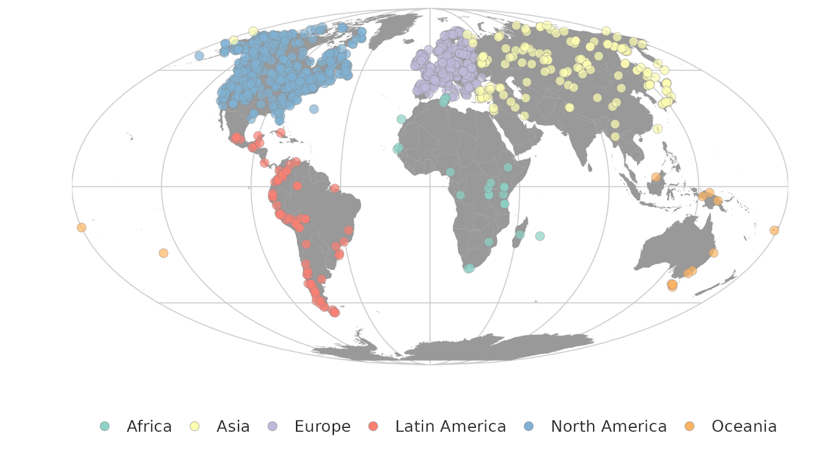

Slide 30








Initial
Geographic
Occupation
Long-term
Short-term

Slide 31
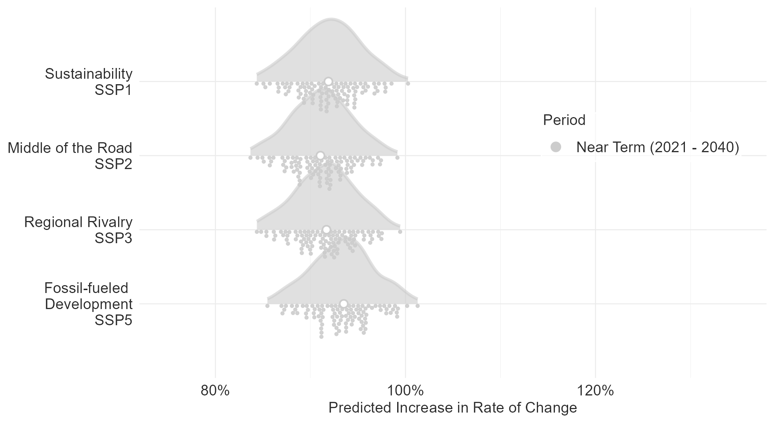
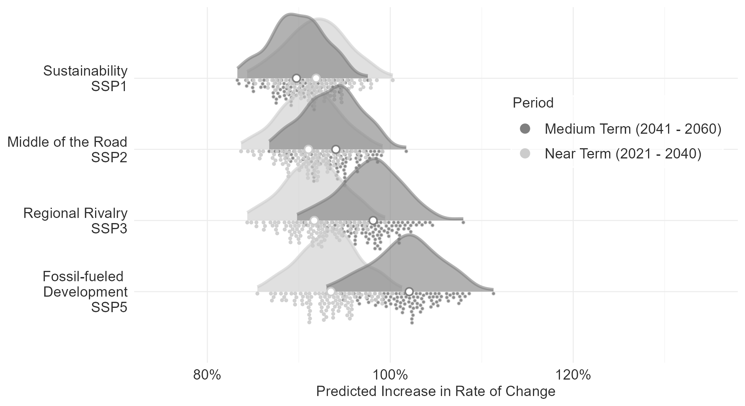
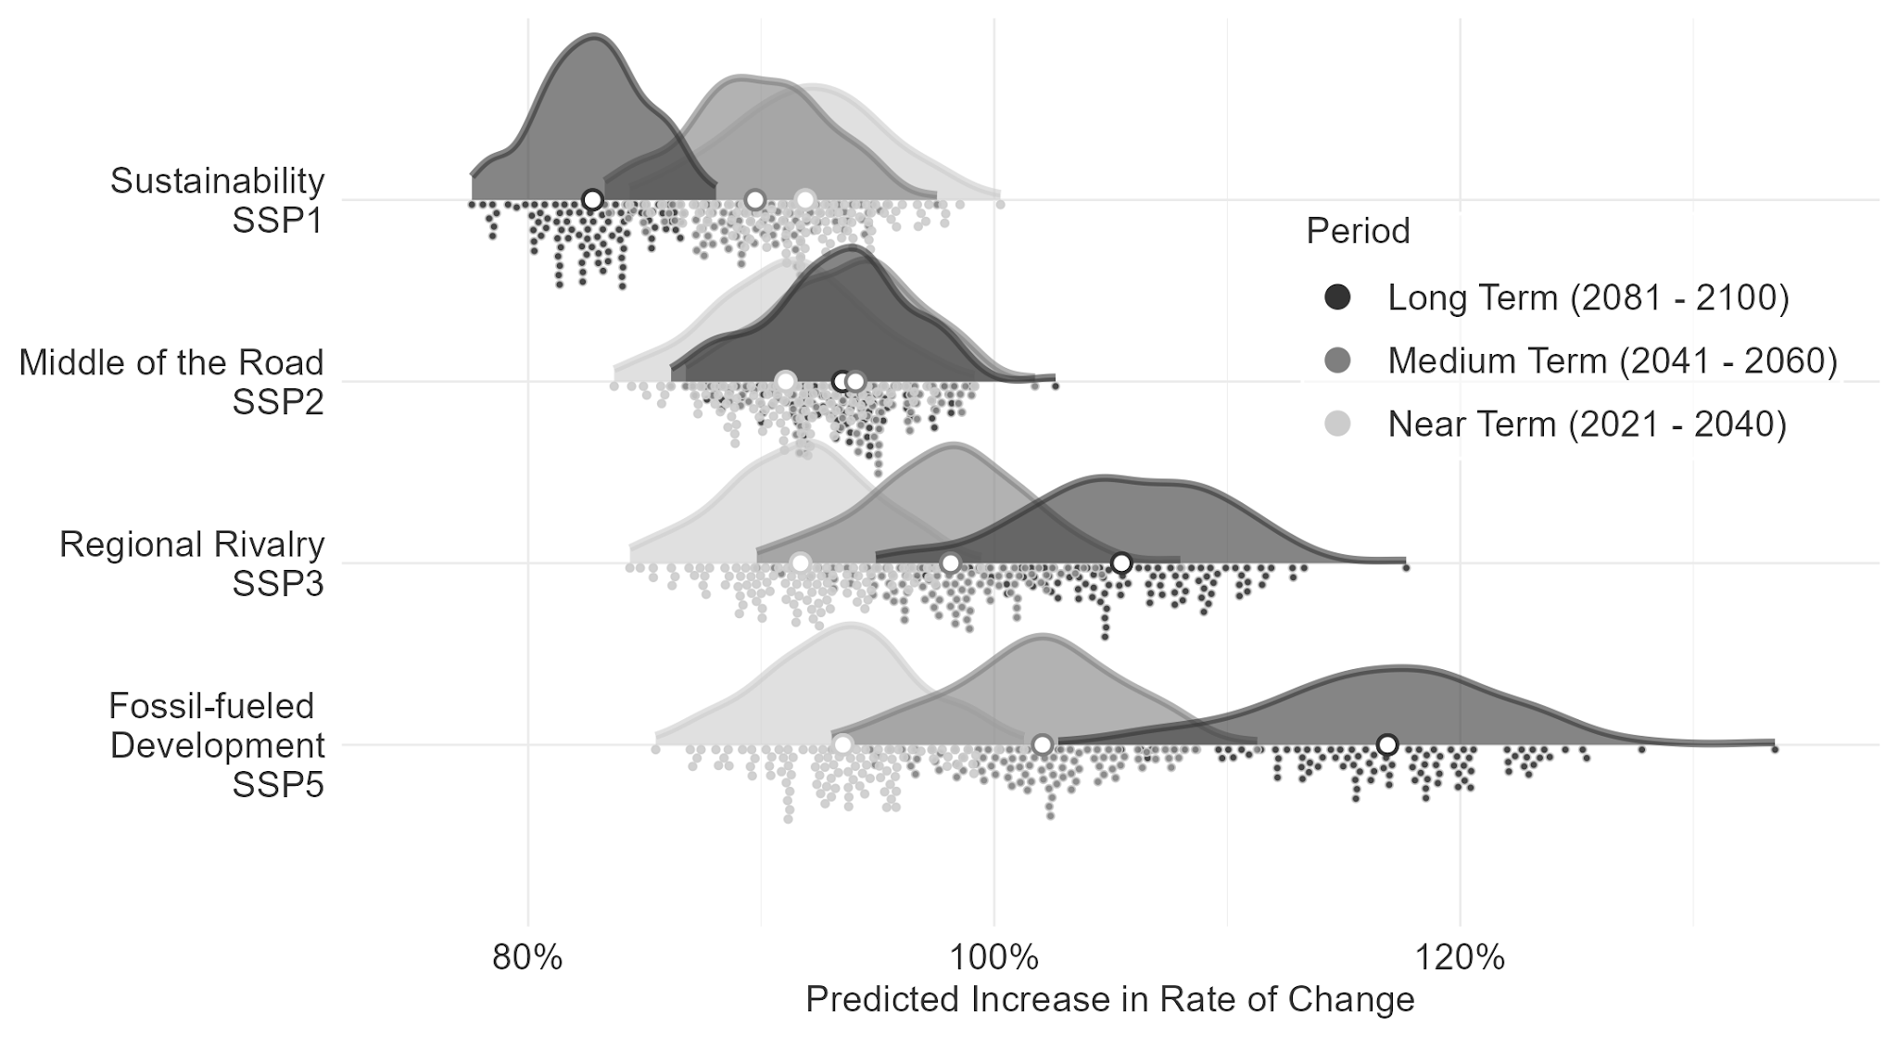

Slide 32
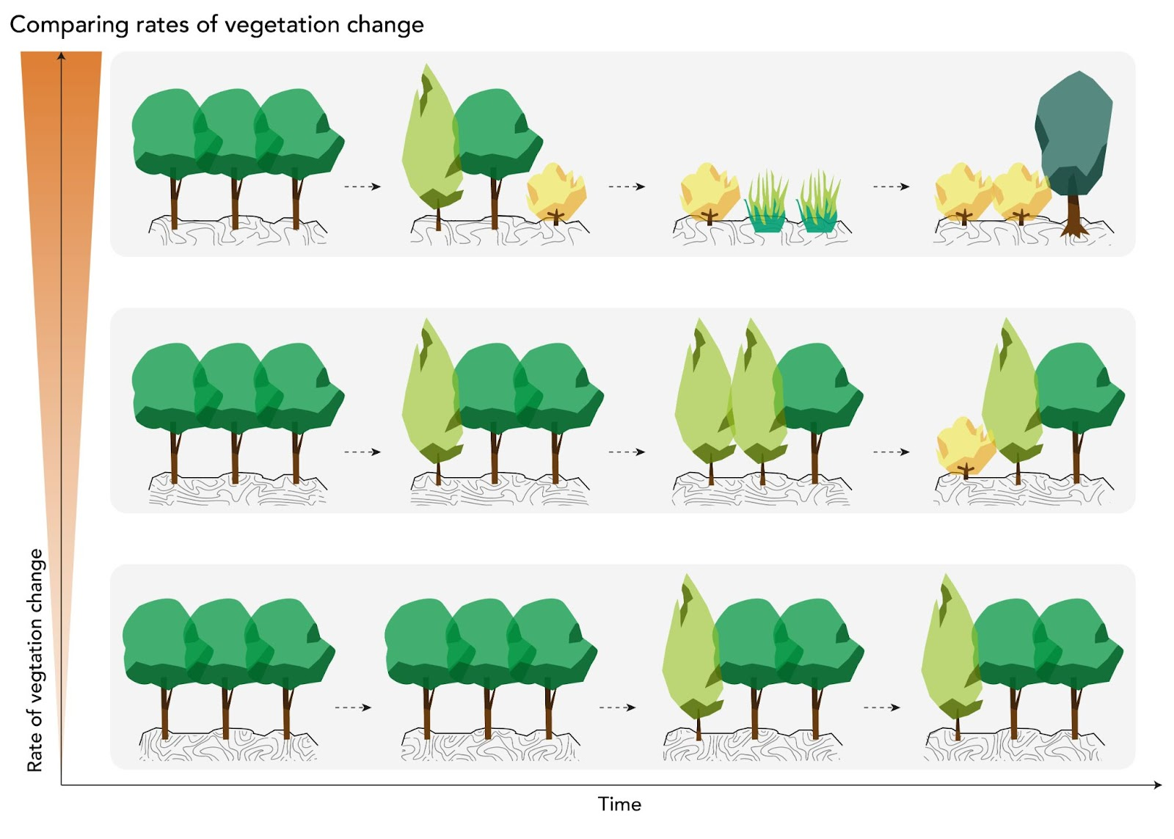

Slide 33
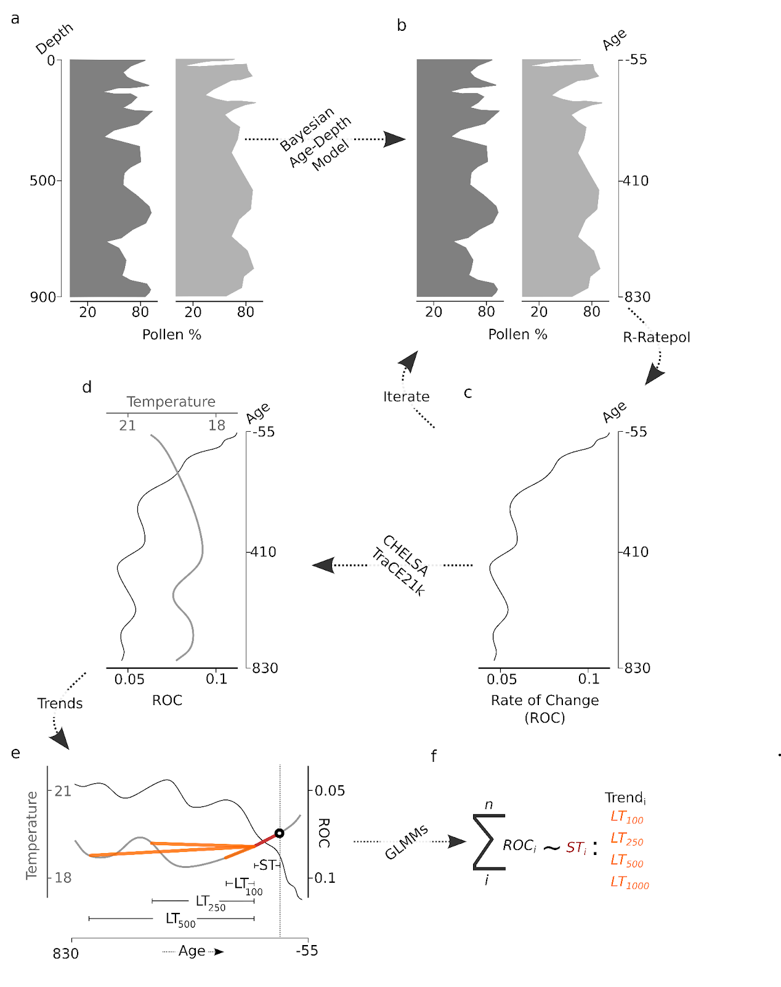

Slide 34
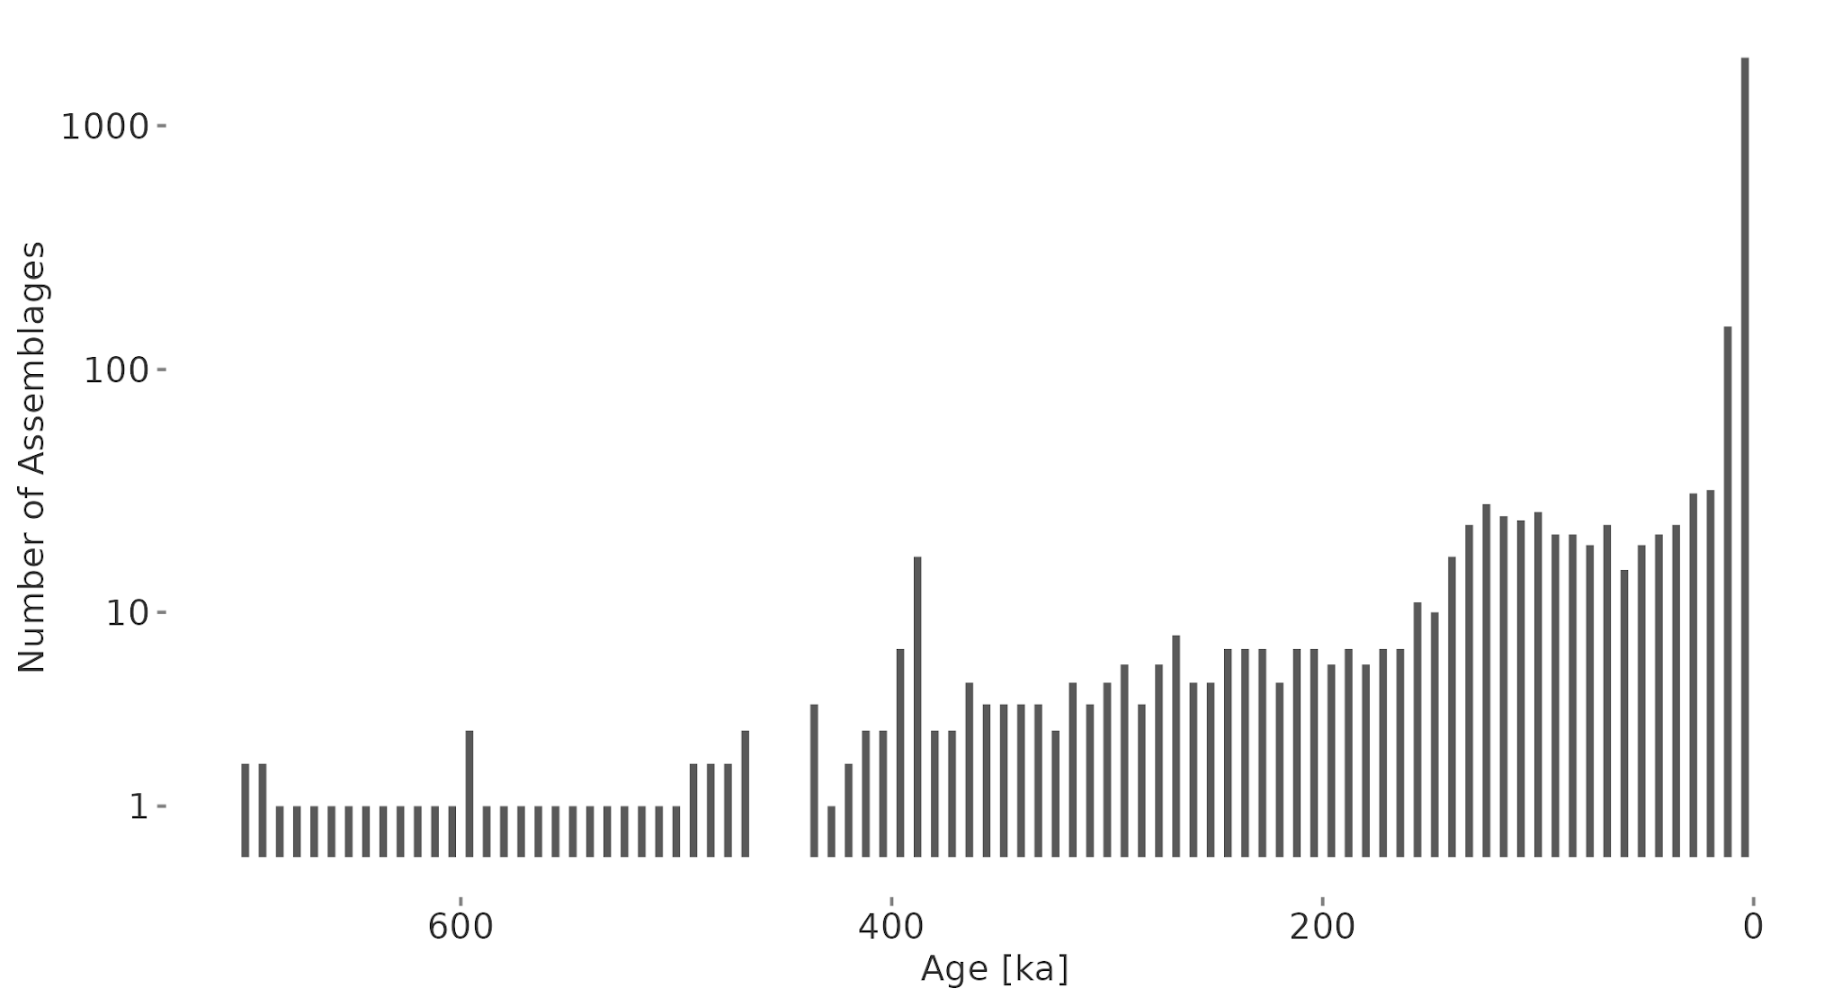
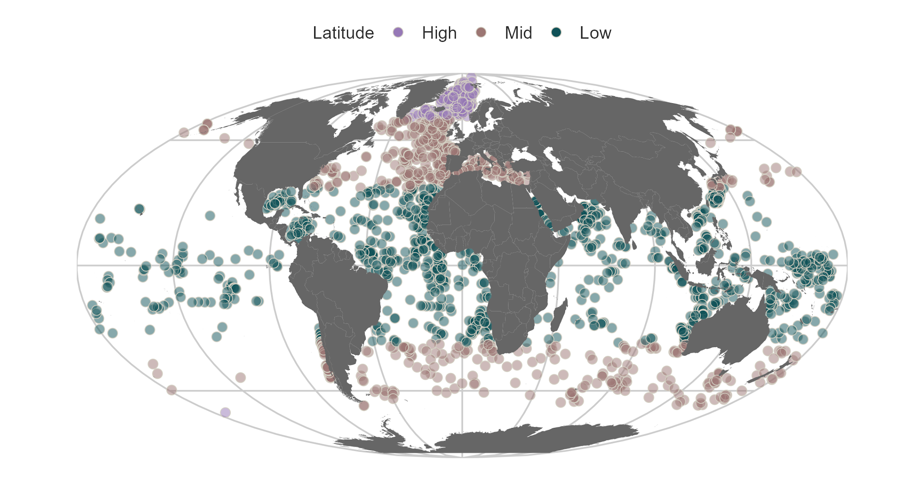

Slide 35




Climatic Mismatch = Actual Temperature - Assemblage Temperature
Assemblage Temperature ~ ∫ Species Temperature Niches

Slide 36



Slide 37





Slide 38


